Slide 1
Tourism Policy in Japan
5th Aug 2015
at ＪＴＣＡ
TERAMAE Shuichi Ph.d
President of Human Logistics labotary
Professor of Teikyoheisei University

Slide 2
The change of the purpose of Tourism Policy in Japan
In the legal system, at first, the purpose of Tourism Policy in Japan was to earn foreign exchange.
But in new Tourism Nation Promotion Basic Law (2006) the purpose has changed to National and Regional pride.

Slide 3
Number of visitors representing the charm of the city
The most number of visitors in the world. Controversy between mayor of London and may of Paris.
Remarks of Governor of Tokyo " Rival is New York, London, Paris".
Travel balance in international balance of payments, the small extremely digit, as compared to the capital balance and technical fee balance.

Slide 4
Ex Tourism Basic Law and Tourism Nation Promotion Basic Law
It is the Tourism Nation Promotion Basic Law which defined the fundamental plan about the tourism of Japan. It is materialized as what expressed the fundamental intention of the people about tourism in the Diet. The plans which the government defines are implementation plans performed according to it. This Tourism Nation Promotion Basic Law carried out full-fledged revision of Tourism Basic Law enacted in 1963, and was enacted.

Slide 5
There is a small book called "the tourism and the tourist industry" which the International Tourist Year memorial event cooperation meeting published in 1967.
Although there was description of "many related legislation is expected by Tourism Basic Law", it was only one Tourist-Facilities Foundation-Collateral Act that it was able to do After all.
It gives an impression that there is a problem in indicator nature as an organic act as compared with having a law directly close to 20 related to Basic Environmental Law. It was kickoff that MP Nikai Toshihiro touched on revision of Tourism Basic Law at New-Year's-greetings in 2003 of the tourism relation organizations.

Slide 6
The old centralized rule to which it was presupposed that the local self-governing body has to follow the national tourism policy existed in Tourism Basic Law. It was revised, saying "the independent measure which employed the characteristic of the zone of a municipal corporation efficiently being decided upon and implemented" in the Tourism Nation Promotion Basic Law. At last, it became the same as the idea which respects local autonomy like other organic acts, such as Small and Medium Enterprise Basic Law.

Slide 7
Tourism Nation Promotion Basic Law supposes that a country will formulate a Tourism Nation Promotion Basic Plan, and it has prescribed realization of a country promoting tourism as a major industry that other plans of a country must be based on this Tourism Nation Promotion Basic Plan. Although it is the contents of revision which satisfy the rarity of the norm nature of old Basic Law on Tourism, in a relation with the tourism plan of a municipal corporation, regulation is not set up directly. At this point, the same system as Basic Environmental Law is taken, and balance is maintained, considering the position of the tourism which thinks the individuality of the area as important.
When Ecotourism Propulsion Act was enacted in 2007, I was very much surprised. It is because that word “KANKO” is not used in a law name but the word “TSURIZUMU” is used. No regulation about Tourism Nation Promotion Basic Law exists in the law at all, either.

Slide 8
In the law about education, regulation of the Fundamental Law of Education is quoted in a certain form. The Tourism Nation Promotion Basic Law has prepared regulation also about preservation of environment or a scene in the regulation as a basic act. Although the Eco-Tourism Propulsion Act was using natural tourist attractions as a legal fundamental concept, a relation with the tourist attractions which Tourism Nation Promotion Basic Law specifies was not touched on.
Tourism Nation Promotion Basic Law was established and its guidance characteristics are doubted in one year. Based on Tourism Nation Promotion Basic Law, I hope that many laws concerned are born.

Slide 9
In fact, by the 1971 revision of the Travel Agency Act, the purpose of tourism policy changed substantially. At that year the number of Japanese overseas travelers exceeded the number of foreign visitors to Japan for the first time.
Ten million program had been launched by the influence of appreciation based on Plaza Accord

Slide 10
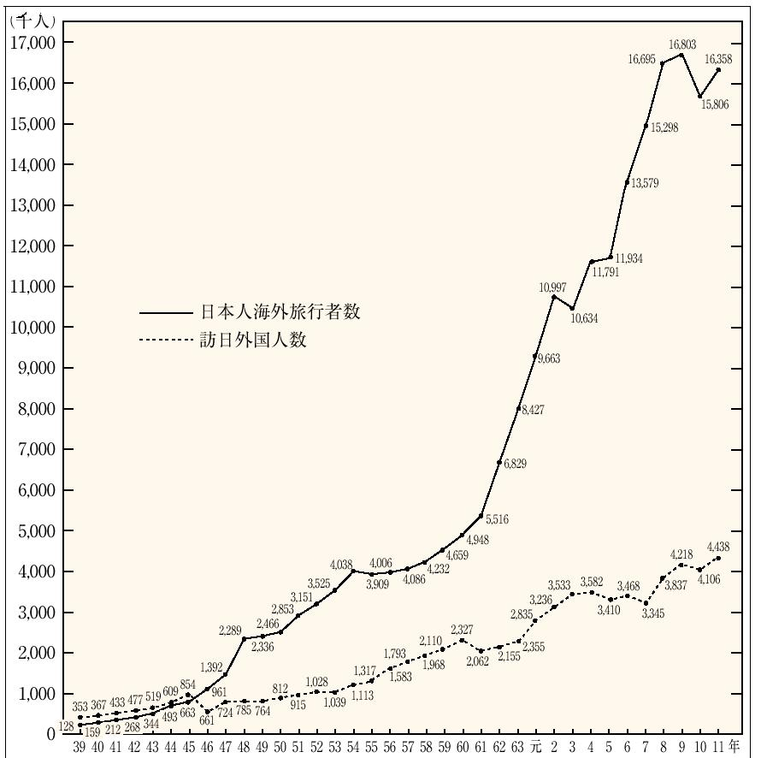
TEN MILLION PROGRAM
（Doubling the number of Japaneseabroad）
5
million
outbound
1963
First year of outbound
5
million
inbound
1964
Tokyo Olympic
1971
Outboud exceeded inbound

Slide 11
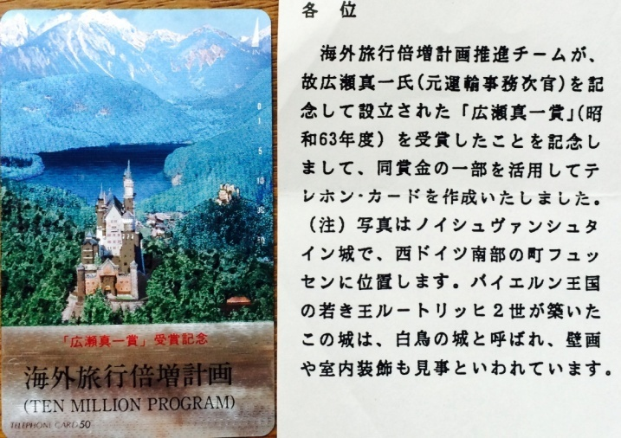
Overseas travel doubling plan promotion team (representative Teramae Shuichi) Hirose Shinichi Prize telephone card (1988)

Slide 12
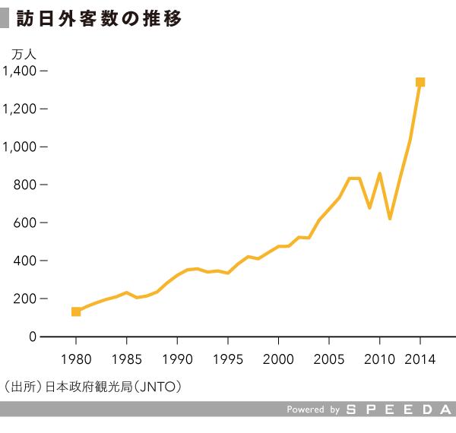
The number of foreign visitors
weaker yen
10 thousand
Economic growth of neighboring countrie

Slide 13
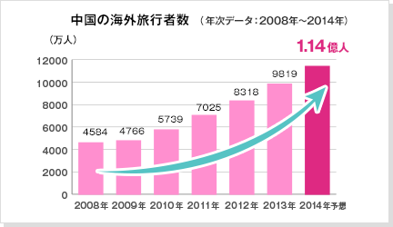
Chinese overseas travelers number
50000
10 thousand
person
11400
11400
2019

Slide 14
The Problem of UNWTO STATISTICS

Slide 15
Definition of tourism is ambiguous.
It is not possible to scientific statistics.
Unable scientific debate.
24-hour rule and the 365 days rule is intended for convenience, it is not essential.
For showing tourism activity larger, double counting is a political action.
Travel expenses for the business is reflected in the price of goods.

Slide 16
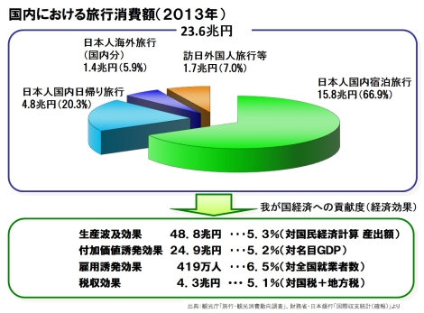
Economic ripple effect of the tourism activity
２３．６trillion yen
48.8
trillion yen

Slide 17
The economic scale of tourist industry
How much is the Japanese economic scale about the tourism? According to the tourism white paper, the tourism industry of Japan extends to the wide field other than travel agency, staying business. And an extensive economic ripple effect and an employment-induced effect are expected.
However, in the travel agency, the amount of trip handling that was 9,920 billion yen in 1996 decreases with 6,290 billion yen by 36.6% in 2011. After the staying business recorded 4,940 billion yen in 1991, a tendency to reduction continues and becomes 2,700 billion yen in 2011, and 45.3% of decrease.

Slide 18
About the direct economic effect to bring to Japanese economy by this, a direct added value-induced effect is estimated at 10,900 billion yen (2.3% of gross domestic products), and an employment-induced effect is estimated with 2,130,000 people (3.3% of number of all employees).
Furthermore, the production ripple effect including the indirect effect that this trip consumption brings is estimated with 46,700 billion yen. As for the value-added ripple effect, 23,800 billion yen, the employment ripple effect are estimated at 3,990,000 people. About the economic effect of the trip consumption, I estimate it in line with global standards-like statistics technique TSA (Tourism Satellite Account). It is detailed in the next HP. http://www.mlit.go.jp/statistics/file000008.html

Slide 19
As for Kazuyuki Matsumoto, it is submitted a problem about the notation method of the economic ripple effect of the tourism. Tourism industry is industry to account for 2-3% of shares in Japan and for 4% of shares in the world total. In the field of tourism, the words "that an economic ripple effect includes" are accepted and the scale is blown up to double size and is expressed. As a result, it causes big misunderstanding. According to the report which World Tourism Organization (UNWTO) publishes, expression to account for industrial 9% of the whole is spent the GDP of the tourism industry for throughout the world. It becomes the cause that many people misunderstand it by this number blown up.
Even if an effect by the increase in foreign tourists and domestic tourists is included according to the judgment only by economic effect, the effect is not big. Rather it has a big economic effect to increase individual consumption.

Slide 20
If you travel not by work but for individual leisure, the expenditure will be the personal consumption expenditure called tourism consumption, and will become a part of GDP. Since it becomes the expense (middle injection) used in order that the company might produce something when it is a business trip of a company, the road stake is not directly contained in GDP. The directions which are interested in Mr. Matsumoto's paper are “http://jairo.nii.ac.jp / 0243/00008065”. Please see. On the other hand about the satisfaction obtained by tourism or a travel, there is a problem whether it can express only with money evaluation of added value. Mountain climbing and a jogging move on their foot without using a means of transportation. Lodging expense will not be added up, either, if a tent is put up and sleep is taken. Although it will not contribute to GDP statistics that much, probably, some are large in satisfaction of the mind. Misunderstanding is large and it reflects the point that Japanese sympathize with Bhutanese myth.

Slide 21
Then, neuroeconomics appeared. Functional magnetic resonance imaging (fMRI) etc. will be used and mental / physiological process in an individual economic activity will be solved by the science neural technique. It is going to make the abstract notion of pleasure into a valuation basis. On the other hand, what is called traditional economics is the learning which solves the selection pattern in an economic activity. Supposing that is right, tourism action theory will be converged on neuroeconomics.

Slide 22
Tourism resources system ～ What mind and regulations produce ～

Slide 25
Basic Law defines "tourism resources“ Country is considered as a target for achieving the "protection, training and development."
「 Cultural heritage (historic sites, scenic beauty, natural monument, etc.) 」
「 The outstanding natural landscape areas 」
「 Onsen (Japan unique) 」
「 Other, tourism resources related to culture, industry, etc. 」 (Basket clause)
ーAdded by Tourism Nation Promotion Basic Lawー
「 Historical landscape 」
「 Good landscape 」

Slide 27
World heritage and Hierarchy-izing of tourist attractions
As for tourist attractions, things chosen from wide areas have authority more. It appears that tourist attractions which prefectural governors select have authority compared with the tourist attractions which mayors select, in many cases. They think world heritage is at the top of authority. However, as for the Imperial property (Kyoto Imperial Palace, Katsura Rikyu, etc.) and divine works of various religious groups, the person in charge does not dare to participate in this hierarchy-ization (popularization).
Japan ratified the "Convention for the Protection of World Cultural and Natural Heritage" in 1992. The neglect period from 1975 of treaty effectuation to ratification of treaties was long. After world heritage was reported for tourist attractions to have an effect, attention came to be paid suddenly. The Diet debate for recognition of necessity was also low.
The treaty tends to save world heritage in the whole human. In the capable countries to protect alone like Japan, the need to actually utilize a registration system based on the treaty is relatively low. When Shirakami mountain range was registered into world heritage, the degree of attention of world heritage was low in Japan. Tourist increase was seen by becoming it, and a world heritage registration campaign activated a world heritage of the Shirakawa volost. However, the visitors of world-heritage-ized Shiretoko were decreasing in number after registration.
In our country, world heritage is also classified according to the form almost corresponding to the cultural assets which the Cultural Properties Protection Law specifies, and the nature park specified to Natural Parks Law.
Therefore, by the internal dimensions of Japan, not by the World Heritage Convention, we can respond to. However, world heritage registration movements are briskly performed in various parts of Japan because higher authority as tourist attractions is obtained.
If category-ization of tourist attractions is attained based on the evaluation from foreign countries (especially from western countries), the persuasion for domestic stakeholders becomes easy. At this point it can be said that Japan is not freed from backwardness. I feel that the hierarchization of cultural assets progresses. A world heritage participates; the world will be put before the first of the turn of "a country, a prefecture and a town" by doing it.

Slide 28
Japan's situation in 1930 before and after
1905 Russo-Japanese War End
1915 First World War
1922 Washington Naval Disarmament Treaty
1923 Great Metropolitan Area Earthquake
1925 Universal suffrage
1929 National Treasure Preservation Act
World depression
1930 Board of Tourist Industry、 Trade Department
Kyoto City Tourism Division
London Naval Disarmament Treaty
Export release of gold
1931 National Parks Law Gold export re-ban
Manchurian Incident

Slide 29
The flooding of hyphen tourism
Many words using tourism are coined. I named "anything tourism" to this phenomenon. I think the reason this word can be used together with many words is that the concept of tourism is on the basis of a difference. In that point there is a commonality with term "information".
While systematizing sociology, Sociologist Karl Mannheim called special sociology to handle specific field “hyphen sociology”, in form in contraposition to “general sociology” to handle social general principles. In sociological field, only the number of domains including "city - sociology -" "family - sociology -" may be made. Then will general tourism studies to handle a maxim of the tourism to contrapose against hyphen tourism studies exist? If general tourism studies do not exist, hyphen tourism studies may not exist.
About words as a kind of hyphen-tourism coined newly, these may be classified in three patterns.

Slide 30
(The first pattern)
Tourism changed as the words that a positive impression leaned on. Therefore, by being combined with tourism, words of the negative image such as slum, dark etc., are accepted in the society.
(The second pattern)
Words of the field where it is recognized that tourism is detrimental clearly are combined with tourism. Eco-tourism and ethnic culture tourism are representatives.
(The third pattern)
Words that combined a value-neutrality-like word with tourism mutually. There are many examples and medical tourism is a representative.

Slide 31
Dark tourism

Slide 32
Generally, the detested thing becomes a tourist attraction. It is classified as a dark tourism, according to the tourism which responds to the instinct which asks for a stimulus of the human being of curiosity. In the times when it was thought that the tourism was a show, the tourism could not have so-called policy laundering effect and was treated like a person of shade. After the proposal of the tourism nation by Prime Minister Koizumi Junichiro, tourism changed to the thing which a positive impression leaned on. Therefore, when the words of minus images, such as dark, a casino, sex, and a slum, combined with tourism, the effect that by which shade person treatment was carried out becomes easy to accept in society came out.
The A-bomb memorial dome, Auschwitz concentration camp, Gole Island which was the bases of slave trade, Robben Island where the prison house of President Mandela was carried out, etc. are often mentioned as negative world heritage. The old battlefield, the remains of a prison, and the remains of a concentration camp is a concrete representative case of dark tourism.

Slide 33
The Guam tourism was started from old battlefield tourism. In Japan, the Abashiri prison was exhibited as Abashiri Prison Museum, and a part of Kanazawa prison was reconstructed in Museum Meiji-village of Aichi Prefecture. Probably, the CEO of Nagoya Railroad company of those days had farseeing intelligence rather than the tourism policy of Kanazawa city of those days was unripe. Thus, the phenomenon in which memory of violence thins in the process in which a prison, a concentration camp, an old battlefield, etc. are commercialized. Masahiro Ogino called it “disinfection”.
Hiroshima City and Japanese Government were negative to world-heritage-izing of the A-bomb memorial dome at first. Although it was because political consideration of not wanting to stimulate the United States, China, and South Korea was working strongly, it was registered in 1996. About the old Korea governor-general's office government building, South Korean public opinion shook between withdrawal and transfer preservation. Eventually, the building was removed and the scene which can overlook Kyong-bokkung was chosen. A slum as an example of the policy which went wrong, the nuclear power generation institution used as decommissioning, and the public facility and tourist facilities that were ruins-ized are also the representative cases of dark tourism. However, disinfection is not completed yet.
The disaster itself, not to mention before disinfection, may turn into tourist attractions. There is testimony that the young people's association member which has come up to Tokyo from rural areas for relief hangs a camera on a head, and is copying and walking, in case of the Great Kanto Earthquake. Although it is because the attractive photographic subject was overflowing, the rumor of having been beaten up by refugees is also recorded.

Slide 34
軍艦島（端島）
「九州・山口の近代化産業遺産群」の一部として、世界遺産暫定リストに追加記載されることが決まり、2009年1月に記載された。しかし、2015年3月に韓国政府が端島の世界遺産登録に反対を表明し、端島を世界遺産登録として認めないように外交活動を行った結果、日韓間で外交問題となっていった。登録はともかく、両者が満足する最終的な決着は何時まで経ってもつかないのであろう。
産業革命も近年では革命という名に値しないと唱える学説が出現しているくらいだから、学校で教えなくなれば話題にならなくなる可能性がある程度のものである。産業遺産という名の集客遺産と思っているから地域も熱が入るのであろう。
韓国も軍艦島を負の遺産として評価をしてこれまで通りの主張を続ける方が政治的には得策なような気がする。地元では「監獄島」とも呼んでいたくらいだから、ダークツーリズムとしての観光客獲得を狙えば韓国人も集客対象になるのであるが、今度は長崎市議会がおさまらないのであろう。両国ともはじめから観光資源との認識で軍艦島を取り扱えば、これほどの騒ぎにはならなかったのではないかと思い、これからの日中韓の観光研究の一つの方向が見えてきたように気がしている。原爆ドームは英雄的行為の証（アメリカ国民）か犯罪的行為の証（広島市民）かで評価はわかれる。しかし日米関係そのものがうまくいっているから、日米の観光客が訪れるのであり、その評価も国家というより個人で行うのであろう。軍艦島も日韓関係がうまくいっていれば観光資源としては問題がないはずであり、ここまでこじれたのは両国の政治家の責任であり、その政治情勢を生み出したものの責任なのであろう。

Slide 35
Dayton method

Slide 36
Western-style “Hotel” and Japanese-style “RYOKAN” Do you take off shoes?

Slide 37
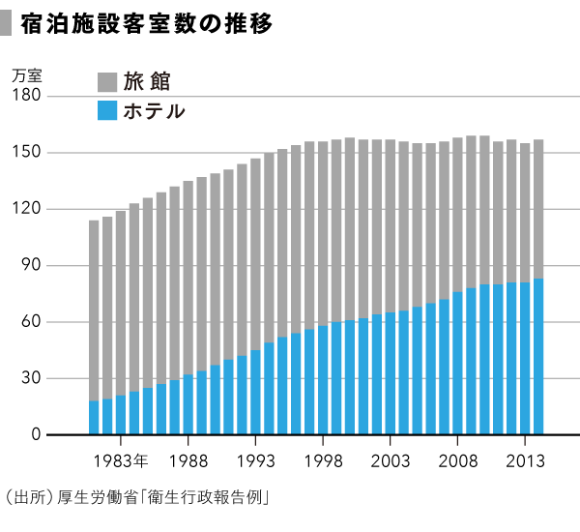
HOTEL（ｂｌｕｅ） and ＲＹＯＫＡＮ（graｙ）
Ten of thousand

Slide 38
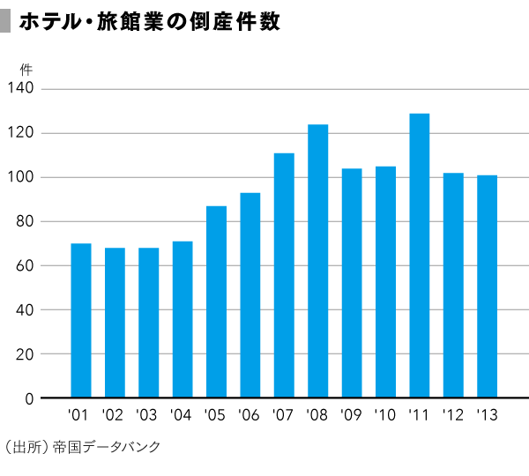
Bankruptcies of Hotel and Ryokan

Slide 39
Everybody understands well that a “Ryokan”（Japanese style hotel）is different from a hotel, but will be troubled when asked about the difference all the time. In fact, it is a system peculiar to Japan to sort in this way.
The necessity of classifying a hotel and a Ryokan legally was borne by the postwar acquisition-of-foreign-currency policy. The severe foreign-currency-control policy continued until Japanese traveling abroad was liberalized. The Act on Development of Hotels for Inbound Tourists enacted in 1949, because the hotels such as “Imperial Hotel” were already requisitioned by the U.S. Forces.

Slide 40
It was thought that Japanese “Ryokan” had a custom of the mixed bathing in those days. It was required to install a bathtub in the guest room of the registration hotel to solve the misunderstanding. There was the rule of the meal, and the condition that could eat a toast as breakfast was imposed. Because the number of hotels was not enough, it was decided that a local high quality “Ryokan” was handled as the International Tourist “Ryokan” which followed a hotel. An image that a hotel was high-quality and Ryokan was for the common people was accepted without any resistance by such a historic process.

Slide 41
There was a Ryokan called Hotel Hyakumangoku in the Kaga hot-spring resort, but this is because an image that a hotel is high-quality was valid. Then what will a Ryokan be different from a hotel? In the early days of the Meiji, they were able to distinguish the house of the Westerner clearly. Because it was a European-style building, they were able to distinguish a hotel from a Ryokan.
The Meiji government which hurries treaty revision tried to construct a European-style city in Tokyo. The building of government and municipal offices was limited to Western-style building by Cabinet declaration.
Now, the style of foreign-origin is at the core of our living environment. Those who are sleeping in the room of the “tatami”（a Japanese-style mat） are decreasing. Distinction of foreign style and a Japanese style will be disappearing. If a Japanese style house is distinguished from a Western style house by force, it request taking off shoes.

Slide 42
It was a Japanese life-style to wear Japanese clothes, to put on Japanese sandals, to put down bedding and to sleep in the room of a “tatami”. Except a Ryokan, it cannot do now. If it takes up as a policy, you should enact “the traditional Japan hotel promoting act”.
It may be misunderstood about ranking of accommodations of Japan also including researchers. Although it is for what purpose to perform ranking, supposing it is visitor-from-outside attraction, it will already have classified into four in Japan. They are four kinds, an international registration hotel, an international registration Ryokan, the hotel that is not registered, and the Ryokan which is not registered.

Slide 43
Differing from a foreign country by ranking is a point which can receive a tax break, when ranking is high. In Europe, if national ranking is high, a tax will also become high. There is even an example which is classifying low by disliking it.
Furthermore, the strange thing has occurred in Japan. By the Act on Development of Hotels for Inbound Tourists, mitigation of a tax can be performed by judgment of a self-governing body. For Tokyo stay ordinances, a tax is conversely imposed by the stay tax. Although a stay tax is collected even in the overseas major cities in many cases, these are used as a tourism promotion source of revenue of the city.
Thus, the dissonance of the policy has occurred in the country and the capital involving the stay tax. The Act on Development of Hotels for Inbound Tourists can be soon said that the time improved completely is coming.

Slide 44
In Japan, there is a rating system for foreigners. Even in tourism researchers, its recognition is thin.
Therefore, even in Japan, the wrong discussion occurs that there is a need for public rating of accommodation facilities.
However, on the contrary, in Japan, the need for a rating system for foreign tourists has decreased.
International Tourist Hotel Preparation Act has been completed the mission

Slide 45
Japan accommodation can be classified into four
Registration
Dilution of policy significance
Registered Hotel
Registered Ryokan
Non-registered Hotel
Non-registered Ryokan
Non-Registration
Obfuscation
Hotel
Ryokan

Slide 46
Dissonance of tax measures
If public evaluation is high, higher tax payments in France, it is low in Japan
Therefore, when you dislike the increase in the taxable amount in France, you purposely lower the evaluation.
In Japan, if the evaluation is high, the country will be cheaper taxes. On the other hand, in Tokyo, it is multiplied by the lodging tax to more than a certain amount of room rate

Slide 47
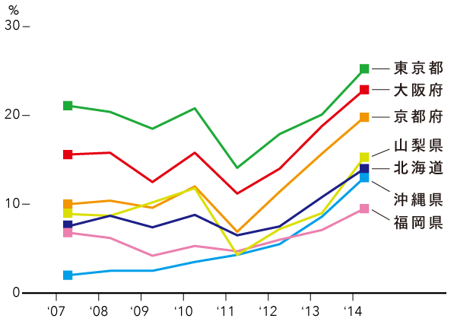
The ratio of foreign tourists guests
Tokyo
Osaka
Kyoto
Okinawa

Slide 48
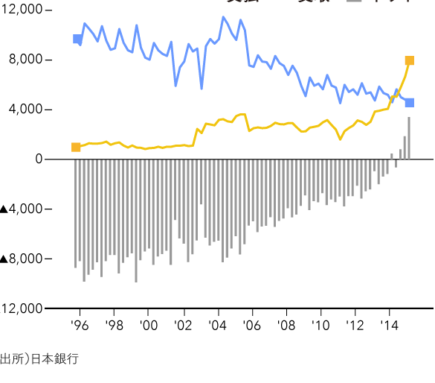
International travel balance of payments
100Million yen
Payment
Acceptance
Balance difference

Slide 49
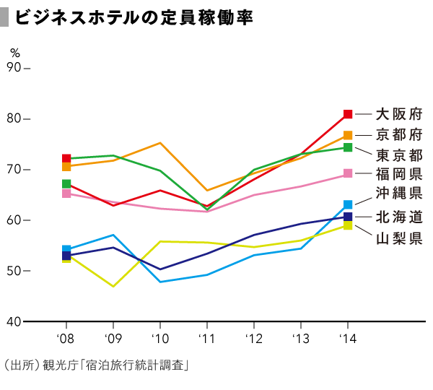
Occupancy rate of business-Hotel
Osaka
Kyoto
Tokyo
Okinawa

Slide 50
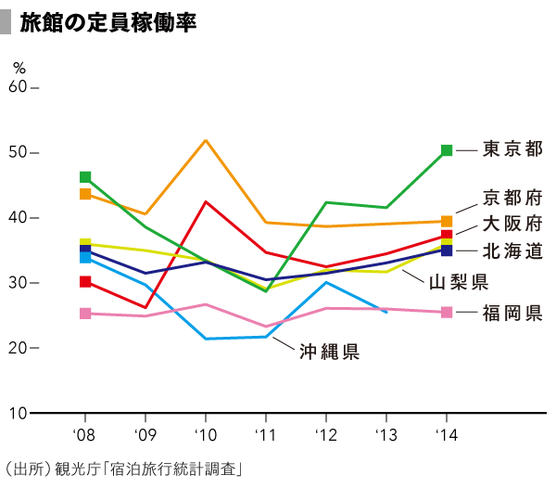
Occupancy rate of Ryokan
Tokyo
Kyoto
Osaka
Okinawa

Slide 52
Hospitality and chip
As for a service, the etymology is the same as a slave. The simple labor which the slave was performing is replaced for a machine or a robot.
However, the people with the talent which can perform creative work are not so many. Let's think about "the way and a future image of the waiting on customers" in the tourism without being confused by the word "hospitality“.

Slide 53
"OMOTENASI" became the center of attention by Olympics attraction. However, because it was probably translated as hospitality and was reported by overseas media, it was domestic subject to the last.
Probably, the relation between hospitality and OMOTENASI will be the same as the relation between tourism and KANKO. In short, it is a problem of a definition of language. I think that hospitality is also a problem of a cerebral reaction.
The sense of the pain may be regarded as a pleasant feeling(SM play) and as pain(violence).The former becomes a crime and the latter can obtain remuneration. Therefore, I think that scientific data is insufficient as a subject of research though it can teach as "skill".

Slide 54
The waiting on a customer skill overlaps with a tip discussion, but the tip overlaps with the issue of labor reward and tax.
During the golden age, the income of the tip of the Ryokan employee were never negligible in the Kaga hot-springs resort and there were many people who spent it as pension non-participation. Probably, there was an appropriate merit also in the employment side.
A golden age was over, and a number of bath visitors decreased sharply, and a Ryokan went bankrupt. The employee fell out of employment for aging. As a result, the phenomenon that they couldn't but depend on welfare for became remarkable (cf. figure). Wisdom to balance a modern hiring with the reward for the waiting on customers skill will be necessary.

Slide 55
The Board of tourist industry in prewar days appealed for the abolition of the traditional tip called“Chadai”which was incomprehensible to the foreigner. However, since the word "chip" was imported after the war, possibly it did not need to appeal for abolition. A tip system was not familiar in Japan. As a result, "service charge" that users were assigned to uniformly was born.
Service charge is listed in a bill separately from a tax even if you go to celebrity restaurants and it is paid by credit-card. I am interested how service charge is distributed.
The practice proposal of "mind of reception" is made in creation of tourism plan. For example, it is "friendly-greeting campaign" that schoolchildren will speak to tourists. However, unlike employee education, argument also comes out whether it is what should be performed by school education. Looking out to unfamiliar persons is also required for education. Since various persons visit in tourist resorts, it is the argument whether it is a mission of administration to just protect children from dangerous adults.
The best seller book "true moment" was written by the president of SAS, Jan Carl Seng. However, SAS went bankrupt after that. Cabin attendants such as JAL should know it before hospitality education.

Slide 56
Not only Jan Carl Seng but also prominent persons of staying industry are giving a speech of the success story at various lecture meetings. My wonder was felt for teaching know-how easily. However, he gets the authority "because our boss appears in media, he is great!" from his young employee. It appears that the activity in mass media is effective in the meaning. Therefore, "mind of hospitality" may be told easily.
Good manner of Japanese in transportation is praised, but, in the Edo era, the townsman and the farmer were not trained at their home. There was only discipline of the work. The elementary school of the Meiji only told the reading and writing abacus and did not train pupils. Even if it was not the result, the scene of the Taisho era was an arrogant trade fair. There was not the custom to hand over a seat to the elderly and an ill person like the present and appeared to be the state of the person victory that persons sat down on earlier. People who had high social position appeared to have possibilities to take tableware even at a party on the Emperor's Birthday hosted by the government.
It is just culture in a manner and will be judging from the existing state of things after all. It is necessary for tourism researchers to criticize it carefully.

Slide 57
The etymology of Japanese word “kankou 観光” which means tourism required for the famous phrase in “I Ching 易経”Chinese classic “to watch the light of the country 観国之光”. In 1930, by royal decree, at the Ministry of Railways, the International Tourism Bureau was established. Royal Decree regarding the establishment of the International Tourism Bureau is the first example using this word as legal one. But the meaning of “kankou” at that time, unlike the origin, changed “to show Japanese culture to the foreign tourists”. Because Deep groove is lying between the origin and the actual meaning, Japanese tourism policy has become hard to understand.
Unusual Ten-million program was launched by Japanese government. which aimed reduction of U.S. dollars held by Japan.

Slide 58
Expanding domestic demand Resort development boom happened Criticism of environmental damage Hotel company and bank failures occurred The so-called bubble Economic bubble burst.
Comprehensive Recreation Area Improvement Act, which many Japanese researchers have criticized, however for tourism, is the first comprehensive law. In terms of legislation, this act is to be judged. In this Act, the word (観光)was not used. Tourism is, in what is not socially recognized yet.
After resort or recreation, the word tourism was recognized Koizumi cabinet Administrative policy speech at the national diet for the first time.

Slide 59
Shinkansen and Osaka World Expo
The railroad fare of JNR was decided concretely by law. It was because the railroad was under state monopoly by the Railroad Nationalization Law. The constitution has determined that the tax must be decided by law (It is the origin in Magna Charta.). It was thought like the tax that the JNR fare had to be based on law as a monopoly price. In 1987 Japanese National Railway (JNR) became the private corporation (JR) and did not need to finally establish the fare in law.

Slide 60
JNR did not sell it directly about pack-tour and took the policy that travel agencies conjugated and sold. "A travel coupon" was born in February, 1955. The uniform travel coupon was a product of the package tour that travel agencies performed and affected the fare system.
The Shinkansen which started business in 1964 had the number of seats 3 times as large as a conventional line. The visitor of the Osaka expo in 1970 counts 64millions people and one-third of persons who visited the Osaka expo was said to have used JNR. The number of Shinkansen was increased sharply especially.

Slide 61
When it did well in Osaka Expo, JNR printed a large-scale campaign corresponding to the demand for post-international exposition decrease out. However, the travel agencies' power also became strong gradually as the tourism tour increased ignited by the expo.
Travel agencies also come to sell by performing product development himself, and rivalry with JNR came to occur.

Slide 62
TOKYO OLYMPIC 2020 and CO-USE(plan) of YOKOTA AIRPORT
Please think about how we should push forward a story about the possibility that a Japanese airline use Yokota base.

Slide 63
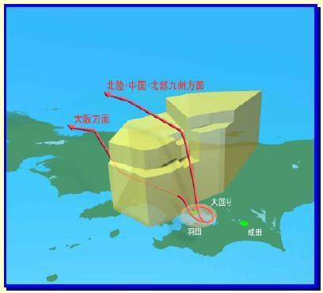
(Yokota airport and air boundary)

Slide 64
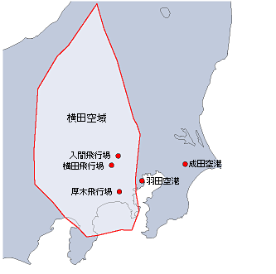
(Yokota airport and air boundary)
YOKOTA
Air boundary
NARITA
HANEDA
YOKOTA

Slide 65
The Olympic Games are held as an aim by national prestige exaltation. The Olympic Games of Tokyo, Seoul and Beijing were held during the rapid economic growth period and afterward led the expansion of the overseas travel of the own nation.
The Olympic Games are the proof of saying that there is power which carries out liberalization of a person, goods and money.

Slide 66
This Tokyo invitation is different from a meeting in a point emphasizing a cultural aspect than an economic aspect in the last time.
This posture is the same as Tourism Nation Promotion Basic Law establishing weight in the local pride.
I think that it is desirable to promote the co-use of the Yokota Airport to let the Tokyo Olympics succeed. A south side is inconvenient for the carrier system of Tokyo metropolitan area. And inhabitants of inland Kanto take a lot access time. It lets you lead the priority regardless of the Olympics and must carry it out.

Slide 67
Break

Slide 68
Break

Slide 69
Comprehensive Resort Areas Development Law（Resort Act）
This law is not a mere campaign, it was defined for the first time of the overall concrete policy on tourism (power act).
In this law, lexical "tourism" does not come appear at all
Regional Tourism Policy researchers, who are often lacking in institutional recognition possessed by this law could not develop a discussion
Concept "tourism" had appeared in this law. However, that lexical "tourism" was not used, it was fortunately in the development of the tourism policy of the Koizumi Cabinet

Slide 70
Resort Development and Comprehensive Resort Areas Development Law
Many tourism researchers are doing severe resort law criticism. However, let's observe from what the viewpoint which an environmentology person criticizes differs. Please observe whether an original viewpoint as a tourism scholar exists.

Slide 71
The Nakasone Cabinet did the Cabinet decision of the measure to stimulation of domestic demand in 1985. It was presupposed that National People's Day will be increased about ten days per year within five years. In order to promote practical use of time at leisure, utilization of private enterprises also checked the plan which can fully be demonstrated. Each ministry hammered out one lengthier stay type resort maintenance concept after another. As a result, the Law for Development of Comprehensive Resort Areas was proclaimed with all six ministries and government offices in 1987.
The fourth Comprehensive National Development Plan by which the Cabinet decision was carried out in 1987 hammered out construction of the Daily Traffic Block in which the day's trip between the major cities is possible. Since leisure time is expanded, it has been described that a resort region etc. are improved. If the Daily Traffic Block will be built, it will go to development of the tourist attractions which want to move humans forcibly.

Slide 72
In comparison with a previous tourist facility construction system giving a foreign visitor invitation on the front and having had been performed, the Law for Development of Comprehensive Resort Areas targeted at Japanese tourists from top front of the legal system. It is just the first law that will tackle a tourism related policy synthetically by two or more governmental agencies.
The reason why expression called “tourism” was not used for directly is that the consciousness of people of those days had not evaluated “tourism” clearly yet. Moreover, in Japanese central administration organizations, it is surmised that it is because the word tourism was evaded as a thing only in connection with Ministry of Transport of those days.

Slide 73
There is meaning of the Law for Development of Comprehensive Resort Areas in having pushed forward the Human Logistics policy as a synthetic measure. Although there was much criticism in respect of a fiscal policy and an environment policy, it was the first comprehensive plan that specified that contribution of tourism was large, in order to activate an area. Since the measure for a supplier side was strengthened for the first time by the ironical thing to the measure of the former, such as social tourism, having been a thing of the consumer side for a worker etc., the Law for Development of Comprehensive Resort Areas could become comprehensive.
The all-round area specification looked at by the Law for Development of Comprehensive Resort Areas was a type of contest administration. However, contest administration also went into the last stage. Almost all prefectures stood as a candidate and they competed for decision of a development concept. However there was no outstanding thing in particular as the result. The breakdown of the Seagaea project in Miyazaki Prefecture was the typical example. Simultaneously, serious environmental pollution like the rapid economic growth era was not brought about.
A scene came to be attached great importance to than facilities construction by the criticism to a resort policy. In addition, it developed from the reflection to a measure without the characteristic to “tourism” to attach great importance to “local personality“.

Slide 74
Inharmony between “national policy” and “regional tourism”
Policy concept involves a norm of fairness. And tourism, especially regional tourism is to develop regional character. Thus we must recognize that there is inharmony between “national policy” and “regional tourism”.
Territory definition refers to land that is put together because of the adjacent terrain and the same nature. A region is the concept of place which is considered the difference between the others.

Slide 75
By the deployment of various initiatives such as balanced national development and the formation of a transportation area one day trip to Tokyo, the differences among regions in Japan, with time, are becoming less and information and communication technology have accelerated it.
The central government can not support regional tourism unlike other exercise of individuality. Tourism administration should have been belonging to the municipal government.
We tourism researchers must distinguish between tourism and tourism policy. The reason to distinguish between policy and non-policy is that standards that apply to the policy is different from those apply to private activity. Occasionally I can recognize in papers the cases of confusing definitions between them.

Slide 76
The reason why a regional tourism policy study does not progress
Concept "regional tourism" and the concept "policy" are disharmony essentially

Slide 77
① A regional tourism policy study to think about "prewar days, wartime and postwar period" in succession did not progress
② A study to perform welfare rest and tourism generally not having been pushed forward.
③ The institutional study of the resort act not having progressed.
④ The old Basic Tourism Act did not intend for "a holiday problem". There not having been the criticism to this.
⑤ The sightseeing makes much of local personality.
"The policy" reduces the difference between the people.Therefore, it is internal disharmony.

Slide 78
Cause that was delayed overall development of regional tourism policy research
① Under '55 regime, the former tourism Basic Law was excluded the "holiday problem"
② Hotel Business Law is a law of the Ministry of Health and Welfare. At the same time, international tourism hotel Improvement Act is a law of the Ministry of Transport. Therefore, double administration has been carried out
③ About Resort law, many tourism policy researchers to perform the evaluation of pandering to the press, and that the depth of the institutional evaluation did not progress
④ Regional tourism policy researchers did not think in a row "before the war, during the war, after the war."

Slide 79
Rural-stay leisure activities Environment-friendly nature experience activities
Tendency to repel "tourism" as a legal term affected the post-war domestic tourism.
Okinawa Promotion Special Measures Law, which was enacted in 2002, defined environment conservation nature experience activities.
Both, by repelling the lexical "tourism", it is coined. Rather, tourism researchers, indifferently, use lexical "agritourism, ecotourism"

Slide 80
Expansion of domestic tourism administration, from being seen in the Ministry of Health and Welfare '50 History
Tourism policy that targets the Japanese before the war is, as supposedly, did not exist.
With the establishment of the International Tourism Bureau, tourism Association was established in various places.
As a result, in the municipality base, the domestic tourism administration is going to stand as implemented was inevitable.

Slide 81
To reflect the difference at the time of the lifestyle, "tourism for Western people business" and "tourism for the Japanese" was quite different. Therefore, it is difficult to selectively use the polite fiction and the real intention.
Therefore, as can be seen also in the documentation for Tokyo Prefecture tourism association, it was decided that with the "Welfare (Recreation"), of the tourism "Our main outside subordinate" is told.

Slide 82
Ministry of Health and Welfare of the government was a part of the home affairs administration. That lexical "welfare" is used as a translation of recreation, had meant that the domestic tourism business is advanced among the Ministry of Health and Welfare administration.
National Park administration and inns ordinances was the typical.

Slide 83
War footing has been enhanced. And, beyond the lexical of "welfare, health, recreation," lexical "tourism" it was not used.
This effect was also continued after the war.
In the Ministry of Health and Welfare administration, lexical "tourism" was not used. Instead, lexical "social tourism" has been used.

Slide 84
Also administration of accommodation belongs to the Ministry of Health, Labour and Welfare.
The Ministry of Land, Infrastructure and Transport, has been responsible for the attraction of foreign tourists. Understanding of the public this is not penetrated.
About the challenges of strengthening of the seismic structure of the inn facility, it would have been likely to tourism administration.

Slide 85
Phenomenon of relative between the unordinary and ordinary
Policy will be implemented through laws, taxes, subsidies, etc. Particularly taxation has been done by force, it is the most normative. Toll, admission tax and entertainment tax (lodging tax, restaurant tax) were introduced for war funding in 1937, which had tourism inhibition effect. Those taxes were abolished after introduction of sales tax of 1989. In the tax system, finally tourism inhibition policy was obsolete. Phenomenon of relative between the unordinary and ordinary occurred in the tax system.

Slide 86
Previously, in general, resort of tourist facilities was more impressive than his home. Today, the home facility is not inferior to tourist resorts in Japan. The phenomenon occurred in relation between resort facilities and living facilities. Common transportation like commuting was strongly regulated in Japan. On the contrary, tourism transportation was weekly regulated or non-regulated. But after deregulation of transportation in Japan, both become similar.
On consciousness, is experiencing the same thing between National parks and home gardens. The same applies to the relationship between national treasure and regional pride (treasure of community). All over Japan, the phenomenon of relative occurred.
Thinking of Tourism development in Japan, this phenomenon can not be ignored. Regional tourism policy objectives are to demonstrate community pride, which is declared by new Tourism Nation Promotion Basic Law (2006).

Slide 87
Phenomenon of relative between the unordinary and ordinary in tourism related legislation

Slide 88
Changes in the concept of tourism in tourism policy

Slide 89
The purpose of establishment of “Human Logistics & Tourism” Laboratory http://www.jinryu.jp/20140410205.html

Slide 90
After the Pacific War was over, Japanese more than 7 million came back to Japan from foreign countries and our economic social revival began from approximately 75 million people. When so-called baby boom generation reached coming-of-age ceremony, the population of Japan surpassed 100 million people. Many Japanese of those days grew with a future dream.

Slide 91
In Japanese economic society, the metropolis absorbed the population from rural areas and it appeared as a movement phenomenon of the space axis of population. The special train which picked up the youth who moved from rural areas to urban areas symbolized this phenomenon. Japanese economic society enjoyed the fruits of population bonus(Demographic Dividend）. We are discussing the issue of low birth rate today. It was estimated that Japan’s population would reach about 100 million by 2050. The big change of the population judging from temporal axis happens in islands of Japan in this century. However, Japanese economic society where 100 million people live in is sure to be continuing after the baby boom generation disappeared. And economic social power of Japan must be a big thing.).

Slide 92
Development of information-communication and transport technology let human exercise activate and greatly changed a human life method. The era of depopulation begins. Population onus (opposite of population bonus) will influence us. It is important for not only Japanese economic society but also individual life to increase visitors. This recognition is becoming strong. It is necessary to use information-communication technology and transport technology, etc. for that. It is time when these technologies should be used for not only tourists in Japan but also tourists in Asian nations where remarkable growth is forecast. We have come at time when it should think about “system creation concerning human logistics” that can correspond to Google and Amazon who develop global new business model.

Slide 93
Artificial intelligence and brain science are accomplishing further progress. Now we must utilize big data collected through information-communication technology. For not only the industry but also human logistics & tourism studies researchers, the analysis based on data having low objectivity to investigate the simple subjective intention such as questionnaires is not permitted. In the business deployment, the time when it cannot help rushing into a new phase at a dash is approaching.

Slide 94
It is important that industrial person, consumer, researcher, journalist concerning human logistics & tourism can exchange opinions. And then they recognize new consumer needs that surround the human logistics & tourism industry and they will develop their economic society by creation of new solutions to answer the needs.
Therefore “Human Logistics and Tourism” Laboratory is established here.
The Head of “Human Logistics & Tourism” Laboratory
TERAMAE SHUICHI , Ph.D

Slide 95
Future Direction of Tourism Policy Studies
"Tourist" concept generated with the popularization of travel. In that case, in Japan, it would be the Edo period in the 18th century when the phenomenon of "Visit Ise Shrine" occured. While the concept was born, the lexical representing it had not been unified. Also its social need was small. If the "sightseeing people" had been used as a lexical representing the concept, there was no confusion. But in Japan, it began to converge in a special lexical "people watching country’s light “.

Slide 96
In Japan, foreign currency acquisition policy had been launched as an important policy in around 1930. International Tourism Bureau (formal English name was "Board of Tourist Industry") for the attraction of foreign tourists was installed, and then trade bureau for the export promotion was installed. National Treasure Preservation Act and the National Parks Law were enacted for foreigners. By the government adopted the lexical "watching country’s light", the concept "tourism" is rapidly began to converge on the lexical" watching country’s light ". Through the Asahi Shimbun and the Yomiuri Shimbun article data analysis, it is demonstrated. Ministry of Railways had been described as the etymology of the lexical " watching country’s light ", which was the I Ching Chinese classical. Its Original interpretation means "outbound". However, the Ministry of Railways was used by the meaning of "inbound". I Ching describes as "going to watch the light of the country." This country in this case, in ancient China meant a fort city. This influence, in Japan, lexical " watching country’s light " has been used as those with cross-border concept.

Slide 97
For International tourism policy of the Ministry of Railways, foreign currency acquisition was an object. However, it was decided to show the attitude of "show the imperial Japanese culture" to foreigners. With tourism advertising business overseas, tourist facilities for foreigners in Japan had been developed. Initially, tourist facilities were easily classified between Japanese and foreigners. However, gradually along with the Westernization of Japanese life, distinction became thinner. The tourist facilities became to be for Japanese tourists in the real intention. Therefore, the policy of local government and local tourism association was referred to as the "inner main outside subordinate". However, under the quasi-war footing, lexical "watching country’s light " did not appear in front. On the basis of welfare administration, the lexical "recreation" and "rest" had been used. This effect was continued even after the war policy. After the end of the war, the acquisition of foreign currency was a national policy, the development of tourism road was carried out for the acquisition of foreign currency. While hotel administration, national park administration and spa administration were done by Ministry of Health and Welfare, the lexical "watching country’s light" was not used.

Slide 98
In the 21st century, Japan entered the population decline society. To expand the exchange population became the existence value of the municipality. Acquisition of foreign currency disappeared from the purpose of the Tourism Nation Promotion Basic Law. Its purpose is "to show the pride of the region”. Saeki Muneyoshi, the founder of Kurobe Alpine Route insisted that Tourism was to show the differences between other regions. On the other hand, the "Policy" is a power act in order to eliminate the differences between people. Of course, between "tourist" and "policy", there is internal dissonance.

Slide 99
In Japanese transport law system, the distinction between daily transport and non-daily transport has disappeared through deregulation policy. In addition, over the policy in general, relative phenomenon of daily and non-daily has occurred. Social sense to divide the only movement for tourism is gone. So, I have proposed the human logistics concept. As well as physical logistics concept, this concept is easy to correspond to the third-party concept being newly developed.
Through location information by smart-phone, it is made to allow the big data analysis of human logistics information. Moreover, through progress in wearable devices, it would become to be possible to grasp the body and the brain reaction against tourist resource in real time. The deployment of the future of regional tourism policy research, with the help of a wearable device, or would not exist at that to discover the tourist culture gene.

Slide 100
references

Slide 101
references

Slide 102
Encounter between Lexical“観光” and Lexical“tourist” ～birth and development of domestic tourism policy in Japan～

Slide 103
The time of generation of concept is apart from the time it is used of lexical
tour
The word tourist was used by1772 and tourism by 1811.
『 I Ching 』「六四 観国之光 利用賓于王」
観光
Japan
The end of the 18th century development of the concept "tourism“. Occurrence of Ise Shrine tour in 1770 is the leading theory
沈約（AD441—513）,Poet of the Southern Song era《悲哉行》：旅游媚年春，年春媚游人
旅游
China
Generation timing of the tourism concept in China, Ming Dynasty 1368 - 1644 second half

Slide 104
The etymology of tourism
Tourism includes two meanings, which are a meaning "to show" and a meaning "to go to look". There is not a case using both without distinction, or, please look for an imminent example.
Human beings began agriculture about 10 thousand years ago, and a calendar became to be important. When the settlement society by farming and by stock farming started, a difference of the status between a king and a commoner was expanded. If a king comes to occupy a status as an actual order person, in order to build authority, the proof of the fact which should serve as the basis is needed. A letter was produced as what meets this demand. It was an occurrence of about 5000 years ago. The calendar which was only a standard that performed agriculture came to function as a legitimate proof.

Slide 105
The history record was left by a letter. It meant the thing called the thing which the contents which the letter expressed wrote down the negotiations with God world, world of Satan, the spiritual world that a letter was a tool of the black art. And it meant that a lie falsehood was not written down. Therefore, the letter stands on the point of contact of myth and history. The "Book of Changes" asked for the origin of a word of tourism is a thing of the time when the king monopolized the letter.

Slide 106
Fortune-telling with the tortoise's upper shell used formally in ancient China was for determining a policy. However, it had in fact the letter of the declaration of a policy or the courtesy of recognition for which it opted. Since it appeared that the form of the crack which appeared by processing the shell of a tortoise beforehand was controlled, it was which was also realistic.

Slide 107
Although many tourism-related researchers ask the Book of Changes for the origin of a word of tourism, the word of the tourism itself does not exist in the Book of Changes. It is because they quoted at twice-or-more-secondhand without confirming the original text. The meaning of "観" in the Book of Changes should be " looking at" not “showing”, if decided through the structure of "fortunetelling" and the pronunciation of Chinese.

Slide 108
Occurrence of social need for the travel for fan which is distinguished from the rest of the journey

Slide 109
Journey of nobility
travel for fan
Popularization
↓
Outbreak of the concept
“tourist”
Policy theory （ relativization between daily life and non-everyday ）

Slide 110
Journey of nobility
Trip for pleasure
Popularization
↓
Outbreak of the concept
“tourist”
Theme of literature
(strain relations)
Active,
Outbound
Passive,
Inbound

Slide 111
Journey of nobility
travel for fan
The need to define “tourism”is becoming lower ↓
Proposal of the concept
“Human Logistics”
Policy theory （ relativization between daily life and non-everyday ）

Slide 112
Journey of nobility
travel for fan
The need to define “tourism”is light ↓
Proposal of the concept
“Human Logistics”
Policy theory （ relativization between daily life and non-everyday ）
Popularization
↓
Outbreak of the concept
“tourist”
Intermediate
goods
Final consumption goods
Theme of literature
(strain relations)
Active,
Outbound
Passive,
Inbound
Tourism Economics
UNWTO

Slide 113
The Chinese-origin-word “KANKO―観光―” and the western-language-origin-word “TSURISUMU―ツーリズム―”
In Japan, the Chinese-origin-word “KANKO” and the western-language-origin-word “TSURIZUMU” are used together. Either is equivalent to tourism in English. “SANGYO KANKO” equivalent to industrial tourism and “EKO TSURIZUMU” equivalent to eco-tourism, both are the representatives. Some Researchers will use the word TSURIZUMU on the grounds that the word KANKO is ambiguous.
When Buddhism came to Japanese archipelago, it was something of a different nature to the Japanese at the time. It was impossible to translate things and thought of the Buddhism into Japanese language. In other words it was impossible to attach a Japanese word at that time to each. Therefore words about the Buddhism are used in the same way as time when those were imported into Japan. And, until today, most of meanings do not change.

Slide 114
Before and after Meiji Restoration, a lot of new concepts entered Japan from the West. Many western concepts were also heterogeneous. But unlike ancient Japan, new words as Japanese were coined using Chinese character. Words equivalent to such as religion, society, constitution etc., survived. Those words are used now not only in Japan but also in Mainland China, Taiwan, Hong Kong and Korea.
Unlike those new coined words, the Chinese-origin-word KANKO exists for a long time in Japan. The opinion is convincing that the etymology of Chinese word “KANKO ―観光―” required for the famous phrase “to watch light of a country ―観国之光―” in “I Ching― 易経―”, one of Chinese classic.

Slide 115
On the other hand, according to Wikipedia, the word tourist would exist as a term in the 18th century and the word tourism would exist as a term early in the 19th century in the western world. Therefore, it is thought that the person who recognized the concept of tourism and tourist existed in Japanese.
According to the database of Japanese leading newspaper “Asahi Shimbun” articles, the Japanese word “TSURISUTO－ツーリスト－” equivalent to a tourist appears many times. On the other hand, the Japanese word “TSURIZUMU－ツーリズム－” equivalent to tourism does not come out at all except last years of Showa era. Therefore it is a curious thing that many Japanese tourism-related textbooks explain that the Japanese word KANKO was called on as an equivalent to tourism in the Taisho era of 1912 through 1926.

Slide 116
“Japan Tourist Bureau” was installed in 1913. Then I can confirm that the word “TSURISUTO” existed but the word “TSURIZUMU” didn’t exist on those days.
After the Age of Geographical Discovery, besides a propagator, a trader, an explorer, a sailor, people who were classified as a tourist came to go on board. In the Edo era, a Japanese group to go abroad did not exist. The concept of tourist should have been incomprehensible for Japanese in those days. Then I think they used directly the word “tourist” without making a new word equivalent to a tourist.

Slide 117
The English name of “KOKUSAI KANKO KYOKU－国際観光局－”set up by an Imperial ordinance in 1930 was “Board of Tourist Industry”. Therefore, unlike a description that an equivalent of tourism is KANKO, it is still natural to think that tourist is an equivalent to KANKO.
Board of Tourist Industry is the first example using the word “KANKO” as legal one. However, the meaning of KANKO at that time, unlike the origin, changed to showing Japanese culture to foreign tourists. Because Deep groove is lying between the original meaning and the actual meaning, Japanese tourism policy has become hard to understand.

Slide 118
The word of tourism is overflowing now. By the reason of the concept of KANKO being uncertain, there are many researchers using the word “TSURIZUMU”. I remember an old Chinese saying that the pot calls the kettle black because of the ambiguity of tourism.
It is necessary for concepts to be unified when we take statistics. In the case of tourism statistics, it is obvious to unify the handling of concept of duties-trip and time length of leaving the daily life sphere of life. It is enforced by a meaning to take the statistics each. If the concept of tourism is vague, “TSURIZUMU” and “KANKO” are also vague in the same degree.

Slide 119
Abstraction of the concept “tourism” and the reason
（Japan,China,Westerns）
Fitting the lexical to the concept

Slide 120
Fitting the lexical to the concept
Lexical "sightseeing"
Introduction of lexical "tourist“
From Westerns
The emergence of lexical Tsu-risuto
(Japanese)

Slide 121
Japan's situation in 1930 before and after
1905 Russo-Japanese War End
1915 First World War
1922 Washington Naval Disarmament Treaty
1923 Great Metropolitan Area Earthquake
1925 Universal suffrage
1929 National Treasure Preservation Act
World depression
1930 Board of Tourist Industry、 Trade Department
Kyoto City Tourism Division
London Naval Disarmament Treaty
Export release of gold
1931 National Parks Law Gold export re-ban
Manchurian Incident

Slide 122
War and Tourism
The Russo-Japanese War was experience of the first trip gained in the form to the call place for many Japanese soldiers. The military post system was born with the Russo-Japanese War, and the mail hit against the battlefield from the inland besides the mail which a military man emits was treated in the Russo-Japanese War for nothing. The custom of writing a postcard was circulated. The spread of tourism picture postcards was also by the Russo-Japanese War.
The difference of national power difference between Japan and Russia was 10 times at the time of the Russo-Japanese War. The national-power difference between the Japan and the U.S. at the time of the Pacific War was also the same 10 times. Since memory of the Russo-Japanese War remained, it is 35 years between both wars, and has the leader of the Pacific War thought that he becomes somehow? In fact, Japan won Russo-Japanese War by the power of U.K. and America diplomatically.

Slide 123
The plan of the old battlefield travel which enlivens feeling further was announced. Sponsorship was Tokyo Osaka both Asahi Shimbun Publishing on which severe sanctions were imposed by the peace contrary. Each newspaper company which lost a scoop called war came to strive for holding of the exposition and event which collect readers' popularity next year of the conclusion of the Russo-Japanese War, in order to win straight victories in the intensified sales campaign.
The school trip to Manchuria was carried out in the next year of the conclusion of the Russo-Japanese War. Although only the politician, a journalist and a student, and the educational group visited around 1917, the travel boom to Manchuria appeared after the Great Kanto Earthquake (1923). It became a nationwide popular tourist resort around 1926, and it reached the peak of 20,000 party-of-tourists totals in 1929 two years before Manchurian Incident.

Slide 124
European countries, starting with Switzerland, set about the establishment of a visitor-from-outside attraction organization after the end of World War I. Japan also installed “Board of Tourist Industry (the international tourism office)” in 1930.
The person with the suffrage was a man aged 25 and over who stores the national tax of 15 yen or more directly at the time of the first House of Representatives election in 1890. They were 1% of population and were landowners fundamentally.

Slide 125
Through the experience of The Russo-Japanese War, many people strengthened recognition that the duty of military service was more important than the duty of tax payment. As a result, Universal Male Suffrage Act was enforced in 1925. "Nation" was institutionalized.
After being institutionalized, it became impossible to neglect a "national intention". If the "national intention" changes, naturally the direction of political will also change. By the "Manchurian Incident" in 1931, an opinion and a demand of "nation" became antiforeigner.
The word "Taisho democracy" is symbolized by female suffrage, emancipation of farming land, and labor law movement. However, the word "Taisho democracy" was built around the 1950s of the postwar period.

Slide 126
Generally, 1931 after 1905 are made into the time of "Taisho democracy." Party politics was realized and the social movement was active at this time.
Supposing you do not understand the background for which “Board of Tourist Industry (the international tourism office)” was founded in 1930, it wonders that tourist industry as non-military industry was established at Manchurian Incident time. However, it can be convinced, if tourism is considered as a policy theory and you understand a historical backdrop. International tourism policy was developed reflecting the social situation after the Russo-Japanese War. Increase of tourists was being enhanced till the early stages of the Pacific War.

Slide 127
Tourism Policy of Imperial Japan
Tourism is called “a passport of peace”. However, the real enforcement about tourism policy of Japan has begun from aiming at enhancing the national prestige of imperial Japan and gaining foreign currency in order to reinforce armaments.
In the Russo-Japanese War, as a result of depending on foreign bond for about 40 % of the cost of war, Japan fell into the state of publishing a foreign bond newly for foreign bond principal-and-interest payment.

Slide 128
In order to improve balance of international indebtedness, tourism policy came to be implemented completely. National Treasure Conservation Act was enacted in 1929, “Board of Tourist Industry (the international tourism office)” was installed in the Ministry of Railroad in April 1930, the International Trade Administration Bureau was established in the Ministry of Commerce-and-Industry in May and the National Park Act was enacted in 1931.
In addition, when setting aside traffic and transport laws, "Historic-relics Scenic Spot Natural Treasure Conservation Act" (1919) and "the law about preservation of an important art object etc.“ (1933) were enacted. In addition, a hot spring, an inn, etc. were controlled by the prefectural ordinance.

Slide 129
The number of visitors from outside in 1929 was 34755 persons (Chinese 16300, Americans 8527). The number of visit-to-Japan visitors from outside in 1932 became 20960 persons and the minimum number since Taisho 5(1916). Also as for tourism income and outgo in 1933, it was in the red of 1,300,000 dollars.
Then, the black figures of 2,700,000 dollars in 1934, the black figures of 3,800,000 dollars in 1935 and the black figures of 5,100,000 dollars in 1936 were generated. The result of the acquisition-of-foreign-currency policy was demonstrated.

Slide 130
The number of visitors from outside in 1936 was about 42,000 people, and the consumption was 107 million yen. Since shipping income and outgo of those days was about 200 million yen, tourist income was important one item of invisible trade balance.
However, solving was difficult for which public office pays overseas tourism advertising expense.
Mr. Egi Tasuku, Railroad Minister, was an important person of the Hamaguchi Osachi Cabinet. Therefore, the imperial railway accounting, only black figures on those days, could pay this expense. It started with the working budget of Ministry of Railroad.

Slide 131
On those days the government was considering government officials' salary reduction. Also in the ministry of Railroad it was at the time of disturbance that all personnel tendered their resignation. Therefore, Minister Egi was said to have contracted his life.
The government official of Ministry of Railroad had impressions, such as "what aims at a foreigner's wallet is not very interesting", and a "beggar", to the policy of this acquisition of foreign currency. That influenced the origin-of-a-word consciousness of the word “KANKO” equivalent to tourism. In the “I Ching”, the original meaning of the word “KANKO” was going to see overseas culture. However, the government official of the Ministry of Railroad made it change to the meaning of showing foreigners Japanese culture.

Slide 132
When Board of Tourist Industry was installed, it was a time of Minister of Finance Takahashi Korekiyo implementing a reflation policy, and freeing Japanese economy from Showa Depression. It is also at the Manchurian Incident outbreak time, and Japanese people were convinced that the Manchukuo establishment was successful. The policy of showing Manchukuo to the world became an important item of "tourism" policy. The Manchurian Incident and the Shanghai Incident attracted Europeans and Americans' interest. The subsidies from the country to the international tourism association in 1939 were 4 times of the previous year.
Nowadays, in the East Asia bloc, when so-called “the issue of recognition-of-history” is discussed, an adverse wind blows on tourism activities. However, in order to develop a calm tourism policy theory, it is required for researchers, such as Japan, Korea, and China, etc. to do research on a tourism policy of those days. The result of the research leads to tourism activation in the East Asia bloc.

Slide 133
Japan Tourist Bureau （1912）
Japan Tourist Bureau
国際旅客奨励会
What was used is a lexical tourist, it is not a lexical tourism nor a lexical kanko（観光）
What is included cross-border concept in the “Tourist” concept

Slide 134
Board of Tourist Industry (1930)
In English “Board of Tourist Industry” not “International tourism Bureau”
Not using “Tourism”
Not using “International”
In Japanese, “international” was used by Minister of railroad’s strong desire
The original meaning of “kanko” was changed from “outbound” to “inbound”

Slide 135
Translation of Tourist
As a concept “tourism” already existed in Japan.
As lexical representing the concept, "sightseeing", “tourism” etc. were present.
In the translation of the Edo-Meiji period, the translation of Tourist was a “ツーリスト(tourist)" instead of “sightseeing". What and why?
In China, there is a concept “tourism” for a long time, it had been expressed in the lexical “旅游”. Therefore, the translation of Tourist was “游客“.

Slide 136
Lexical "sightseeing"
Introduction of lexical "tourist“
From Westerns
The emergence of lexical Tsurisuto(Japanese)
1912
Japan Tourist Bureau
（Japan tsurisuto Byurou）
As Private Body
Synchronization of the lexical "tourist" and the concept "tourist"

Slide 137
Convergence to the lexical "tourist"
Acquisition of foreign currency (policy)
1912
Japan Tourist Bureau
1930
Board of Tourist Industry
(in ministry of railroad)
Synchronization of the lexical "tourist" and the concept "tourist"

Slide 138
Tourist in this case, the foreigner
Acquisition of foreign currency (policy)
1912
Japan Tourist Bureau
1930
Board of Tourist Industry
Synchronization of the lexical "tourist" and the concept "tourist"
Emphasis on inbound concept
(Show the Imperial Japan)
?
The presence or absence of cross-border concept

Slide 139
Convergence to the lexical "tourist"
×
National wartime mobilization (policy)
Acquisition of foreign currency (policy)
1930
Board of Tourist Industry
1938
The establishment of the Ministry of Health and Welfare
Domestic tourism concept
is undeveloped
Emphasis of lexical "recreation"
Emphasis on inbound concept
(Show the Imperial Japan)

Slide 140
From When？
Concept “tourism”
Lexical “sightseeing”
Lexical “kanko(
Tourism)”
Lexical “kanko(tourism)”
Lexical “kanko(tourism)”
Concept
“tourist”
into Japan
Acquisition
of
foreign currency（policy）
Lexical
”tu-rizumu ”
Lexical
「ツーリスト
(tourist)」
Board of
Tourist industry
1930
Japan Tourist
Bureau 1912
Lexical “recreation”
The presence or absence of cross-border concept
Increase of inbound concept in tourism
Synchro of
Concept”tourism”
and LEXICAL”tourism”

Slide 141
Expansion hypothesis of "tourism" concept
Hypothesis ①
outbound only⇒ inbound emphasis
Hypothesis ②
cross-border concept ⇒ non-discriminatory
To affirm or deny the hypothesis
Quantity analysis of lexical use of the Edo-Meiji Period- is required
Printed literature is 2-3%.
Scientific empirical analysis is difficult.
For the time being the use of the newspaper article search
Literature analysis remains in the supplementary materials

Slide 142
Outbound ⇒ inbound hypothesis
In the era of privilege class has the fun of travel, the concept "tourism" would be outbound concept
Through the popularization of the fun of travel, industry, the tourists were targeted to grow, inbound concept has been established (hypothesis)
In the case of Japan, we used lexical "tourism" as representing the inbound.

Slide 143
“Ｓhowing the light of the country."
As examples of "showing the light of the country", there is an example that says the concept of age Festival in 1895. Have appeared conscious that indicates the light of the country to foreigners here.
In 1915, historical landmark scenic natural monument Preservation Society was established. Description "exert the country of light" was seen at that time.

Slide 144
Cross-border concept hypothesis
Contemporary border concept was established after the First World War.
Country indicated by the I Ching is an urban concept.
There is a tourist map of the local tourism association has been issued in 1938. This map has been described as "border tourist map." Although not an international, it is stuck in the "country". It has refers to the country in the Japan of the Edo era.

Slide 145
In “Japan Tourist Bureau”, the lexical "sightseeing", "tourism", and the like of it used the way
At the time when Board of Tourist Industry was installed, in general society, examples of the lexical "sightseeing" and lexical "tourism" were not established
At the time, the Ministry of Railways and Japan Tourist Bureau officials were an expert.
Even more, the general public, was considered to be not reached the stage of selectively using the sightseeing and tourism.
This is currently used "tourism, sightseeing, excursions, migration" is the same in.

Slide 146
"Itinerary and cost estimates", "tourist guide Monographs"
“Itinerary and cost estimates” and “tourist guide Monographs” are the first official tourist guide in Japan.
Overall, the excursion was being used, migration, round, had also been used tourism. There is no uniformity in the use of the term.

Slide 147
Wikipedia「tourism」
「Tourism is commonly associated with international travel, but may also refer to travel to another place within the same country.」
In 1936, the League of Nations defined a foreign tourist as “someone traveling abroad for at least twenty-four hours“. Its successor, the United Nations, amended this definition in 1945, by including a maximum stay of six months.^{[9]}

Slide 148
Comparison of the frequency of use between 「sightseeing(遊覧)」 and「tourism(観光)」 through Asahisimbun articles database
period | sightseeing | tourism
１８７９～１９００ | ２３５ | ４８
１９０１～１９１０ | ３４２ | ６４４
１９１１～１９２０ | ２１１ | ６８０
１９２１～１９３０ | １５３ | ３２３
１９３１～１９４５ | ２００ | １０３９
１９４６～１９８９ | ２５８ | ５４９２

Slide 149
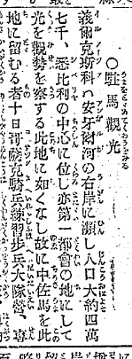
First example in addition to proper noun
15th autumn 1895
「WATCH THE LIGHT WITH PARKING A HORSE
(駐馬観光)」

Slide 150
Example of "tourism" in the Yomiuri Shimbun article search
At first it was only examples of specific business card in advertising ("tourism small magazine," "tourist light").
For the first time common noun of examples appeared in morning edition August 18, 1897.
Its contents, was that Taiwan's indigenous peoples have moved to Tokyo for the inland tourism of Japan.

Slide 151
First example to be used for the domestic movement of Japanese by the Asahi Shimbun and Yomiuri Shimbun
Among examples of the lexical "tourism" there are many things beyond the border, I try to overview the example to be used for domestic movement of Japanese.
The first article is a morning newspaper May 19, 1909.
It was an article about the Hokkaido tourist group of Yamagata Prefecture people by Yamagata Prefecture Daily sponsored

Slide 152
Examples of “tu-rizumu(tourism)” in newspaper article
In the Yomiuri Shimbun and Asahi Shimbun, from the time of issuance newspaper (1874, 1879) to the pre-war period, example of "tourism" is nil.
In the newspaper, came to the lexical "tourism" is used in general is that since Prime Minister Junichiro Koizumi began chanting tourism.

Slide 153
Example of the use of “tourism ” (Asahi Shimbun) After the war - Showa last stage only 5 articles

Slide 154
Local tourism association
From 1934 around, the Ministry of Railways and stressed the public health movement.
For League members of the local tourism association, subsidies have been paid from the International Tourism Bureau. Free ride card has been paid to the district representative.
The supposedly, in order to distinguish between intelligence, it is emphasized to unify the response to foreigners.

Slide 155
Using the lexical "tourist" in the Rural Tourism Association
As a result of the influence of the establishment of the International Tourism Bureau in 1930, in 1935, the number of tourism organizations that have been installed in the country has exceeded 400.
From the fact that there is a need for national Federation, Japan Tourism Federation, which is supervised by the Ministry of Railways International Tourism station has been established.
Financial funds could not be used for Japanese to excursion. Therefore, discrepancy occurs in supposedly the real intention. Although the head is an international tourist, legs was a national health. This went also affects the post-war tourism concept.

Slide 156
Kyoto City
1930
To set up a Tourism Division
1935
The name, it will change from sightseeing city to tourist city

Slide 157
Tokyo Prefecture
In Tokyo Prefecture, it had conducted a tourism administration in Natural Park Division of Construction Bureau.
Tokyo Prefecture Tourism Association was established in 1936.

Slide 158
Hypothesis expansion of the concept "tourism"

Slide 159
Hypothesis ① Use only in outbound Etymologically speaking ⇒ To emphasize the inbound （ Tourist Industry has occurred ？）

Slide 160
Hypothesis ② Cross-border concept ⇒ non-discriminatory

Slide 161
Hypothesis ② Cross-border concept ⇒ non-discriminatory

Slide 162
The proof of the hypothesis ①②
Analysis of the quantity of the lexical used in the past required
⇒
It relies on the success of Amazon and Google

Slide 163
Mechanisms that domestic tourism destination has occurred
Acquisition of foreign currency
OUTBOUND
Sightseeing
Etymologically speaking
INBOUND
Destination
Inauguration of the international tourism administration
1930
International tourism
(Overseas tourist propaganda)
Domestic tourism
(Facility development for foreigner)

Slide 164
International tourism
(Overseas tourist propaganda)
Domestic tourism
(Facility development for foreigner)
National Treasure Preservation Act
1929
National Parks Law
1931
For western people
Clear differences in lifestyle
(at that time)
Ryokan
Japanese food
Scenic spot
scenic district
Sumo
For Japanese
people

Slide 165
Lexical “health and recreation”
For western people
Westernization
Relativization
Popularization
Public stance
Clear differences in lifestyle
(at that time)
Development and deployment of welfare administration
For Japanese
people
Real intention
The inner main outside follow

Slide 166
Tourism Policy in wartime
Nominally welfare administration
1940
Phantom of the Tokyo Olympic Games
1940
Phantom of World Recreation Tournament
Hiking
Excursion
Ministry of Health and Welfare
Recreation administration
Local Association
(Tourism, scenic beauty)
Ministry of Railways
International tourism administration

Slide 167
Deployment of postwar domestic tourism administration
Tourism Policy in wartime
Nominally welfare administration
1940
Phantom of the Tokyo Olympic Games
National Sports Festival
Recreation and sports administration
Ministry of Education
1940
Phantom of World Recreation Tournament
National Recreation tournament
Social Education Act, Museum Act, Community center Act and Library Act are using the lexical "recreation"
Inn administration
Hot spring administration
National park aministration
postwar welfare administration
International Tourist Hotel Improvement Act
（for foreigner）
postwar International Tourism administration
The trip mediation work act （for foreigner）
Cultural Properties Protection Act

Slide 168
Deployment of postwar domestic tourism administration
Ministry of Education
Recreation and sports administration
Cultural properties protection administration
Integration
Social tourism
welfare administration
Inn and restaurant
administration
The lodgings for the nation
holiday village for the nation
Comprehensive Resort Areas Development Law
Hot spring administration
National park aministration
Integration
Environmental administration
For Japanese
International Tourist Hotel Improvement Act
（for foreigner）
The popularization of the International Tourist inn
International Tourism administration
The trip mediation work act （for foreigner）
Travel agency act

Slide 169
The birth of the "public welfare" ministry and development of the domestic “tourism" policy
A sign to develop into a policy concept including the country by the establishment of the International Tourist station came out.
However, what is the reason why there was not an expanse afterwards?
Wartime, for principle, there was a trend in disfavor with entertainment.

Slide 170
The end of occupation by US-Army, and The birth of domestic tourism
The biggest subject after the end of the war in Japan was food reservation. Since even agricultural engineers gathered together for the war, trouble had occurred in the food production in Japan as a result. The acquisition of foreign currency for food reservation was pressing need, and it had been recognized as visitor-from-outside attractions being primary importance. It was no match for today's Cool Japan Campaign.

Slide 171
Since a hotel indispensable to visitor-from-outside attractions was used for occupation forces, a hotel newly needed to be secured and the Act on Development of Hotels for Inbound Tourists(International Tourism Hotel Preparation Law) was enacted by the lawmaker proposal.
In prewar days, Tourism mainly pointed out visitor-from-outside attractions. It was after “the Ministry of Transport Act of Incorporation” in 1949 that domestic tourism was included in this.
Although the word “KANKO” was used for official documents in 1946, this was chiefly related with an occupation-forces soldiers-oriented tourist bus. They were the vestiges which had used "KANKO" for visitors from outside from prewar days.

Slide 172
The license standard of the passenger automobile transportation enterprise was eased sharply in 1950. Then, the name was borrowed from the importance of the tourist industry and the conditions of not consuming fuel precious to unwholesome tourism and a picnic were given. As for this, it served as a backdrop that many bus companies by whom "tourism" was entitled were established the title for visitors from outside. The actual condition made it observe that a bus was used for domestic tourism.
The tourist industry regulated with the National-Mobilization-Act system turned into an unrestricted operation during war after the war. Since the glare of GHQ (occupation forces) was effective in formation of U.S. occupation, the regulation with law was unnecessary. Even if the revival term came around, the necessity for visitor-from-outside attractions was still high. It prepared for issue of the San Francisco treaty in 1952, and the Travel Recommendation Business Act was enforced for vicious travel agent control. It was because GHQ stopped having authority.

Slide 173
Compared with the Japanese travel recommendation business only for Japanese people, the deposits as security for dealing to the general travel recommendation business also for foreigners were made big-ticket.
Hotel Business Law and Hot Spring Law were enacted in 1948. The law about interpretation-guide-business, and the Act on Development of Hotels for Inbound Tourists were enacted in 1949. The above-mentioned Travel Recommendation Business Act was enacted in 1952. The legal system about the valid tourism till today was improved mostly at this time. There was no big system change until it continued till today after that except the Travel Recommendation Business Act.

Slide 174
Movement toward re-maintenance of tourist attractions was also activated, Ise Shima was specified as national park in 1946, and the National Park Bureau was installed into the Ministry of Health and Welfare in 1948. The National Park Act was revised in 1949. As a result, harmony of scene maintenance and tourism will be achieved by park plan system.
The legal system of specifying cultural assets synthetically is the Cultural Properties Protection Law ignited by the Horyuji Temple fire-by-negligence incident. It was enacted by the lawmaker proposal in 1950. From the explanation of proposal reason of Cultural-Properties-Protection-Law, we understood the thought that cultural assets were recognized as tourist attractions existed.

Slide 175
Tourism Basic Law was enacted by the lawmaker proposal as the fifth organic act at last after the war in 1963. However the law enacted after that based on Tourism Basic Law was only Tourism Foundation-Collateral Act. As for Tourism Basic Law, a role of an organic act was not demonstrated.
With the improvement of international balance of payment, the visitor-from-outside attractions idea for the acquisition of foreign currency which is the most important policy idea of Tourism Basic Law has carried out real disappearance.
The number of Japanese overseas travelers exceeded the number of visitors from outside in 1971. When Travel Recommendation Business Act was revised by the Tourist Agency Law, the tourism policy changed from the measure for foreign tourists to the measure for Japanese overseas travelers.

Slide 176
If the translation of concept “Tourism” was lexical "sightseeing", deployment of Japanese tourism administration might have changed.

Slide 177
references

Slide 178
references

Slide 179
Introduction to Human Logistics ＆ Tourism Science in Japan http://www.jinryu.jp/201411171685.html
References １
Content

Slide 180
Chapter１ Principles of Human Logistics & Tourism
１ Meaning to think about human logistics & tourism
２ The Chinese-origin-word “KANKO―観光―” and the western-language-origin-word “TSURISUMU―ツーリズム―”
３ The flooding of the hyphen tourism
４ Maintenance of the race culture and tourism promotion
５ Relativization of daily life and non-daily life
６ Temporal axis and spatial axis of human logistics

Slide 181
Chapter 2 The History of Human Logistics & Tourism In Japan
１ From the slave trade era to a century of immigrant
２ An epidemic and human logistics
３ Birth of the concept of tourist
４ Visa & Tourism
５ War & Tourism
６ Tourism policy of Empire Japan
７ “Cool Japan policy in 1930’s” through using Asahi Shimbun article database
８ The end of occupation by GHQ and the birth of domestic tourism
9 Foreign visitor invitation & promotion of overseas travel of Japanese
１０ Birth of perpetual tourist

Slide 182
Chapter 3 Tourist Attractions ～tourists‘ viewpoint～
１ What are tourist attractions?
２ Evaluation of Bill Gates’ personal computer
３ Scenery of meaning and scenery of optical sense
４ Birth of a national park
５ History and tradition that can reproduce intentionally
６ Regulation and tourist attractions ～gamble, obscenity , drug, violence～
７ Tokyo overconcentration of tourist attractions

Slide 183
８ World heritage and Hierarchy-izing of tourist attractions
９ Japanese-style food, Class B-gourmet, and a packaged portable train lunch-box
１０ Animal protection and abuse
１１ Medical Tourism
１２ Ecotourism and natural woodland tourism
１３ Religion as tourist attractions
１４ Dark Tourism
１５ Space Tourism

Slide 184
Chapter４ Activities for tourists～Viewpoint of supplier side～
１ The economic scale of tourist industry
２ Movement of natural persons and money

Slide 185
Sub-Chapter１ Tourist industry
１ Classification of tourist industry～The difference between a tour operator and a travel agency～
２ Travel agency and fee business
３ Mystery of package tour fare system
４ Analysis of the criticism against mass tourism
５ Jumbo jet and JAL pack
６ Shinkansen and Osaka World Expo
７ Accident during traveling abroad
８ Itinerary guarantee responsibility
９ Basic problem of the travel agency
～gap between the itinerary guarantee responsibility and inclusive tour rate～
１０ Single article package tour
～mysterious merchandise uniquely in Japan～
１１ Monthly riding free fixed amount fare

Slide 186
Sub-Chapter 2 Passenger transport business
１ Functional differentiation of passenger transport business
２ Expansion of one-day traffic area and Tokyo overconcentration
３ Code share and cabotage
４ Open-sky policy and birth of LCC
５ Tokyo Olympic 2020 and Co-use of Yokota Airport
６ Tourism and Linear Shinkansen

Slide 187
Sub-Chapter 3 Staying business
１ Western-style “Hotel” and Japanese-style “RYOKAN”
２ Living apart of staying business and restaurant business
３ Hot spring business as the around big city location industry
４ Earthquake resistance and Japanese-style hotel in hot-spring
５ Regulation and evaluation of a hot spring
６ Hospitality and chip

Slide 188
Chapter 6 Tourism Policy
１ What is tourism policy？
２ Tourism Basic Law and Tourism Nation Promotion Basic Law
３ Tourism and Vacation
４ Long Stay and Overseas Emigration

Slide 189
Sub-Chapter１ Construction and Maintenance of Public Facilities
１ The times of social tourism
２ Tourism and Recreation
３ Resort Development and Comprehensive Resort Areas Development Law
４ Abolition of Public Accommodations
５ The life study facilities which become a theme park
６ Meeting Incentive tour Convention and Exhibition
７ Sustainable Tourism and Capacity of the earth

Slide 190
Sub-Chapter２ Region and Tourism
１ Tourism and Media
２ Appropriate placement of Urban Area and Rural Area
３ Urban Tourism
４ Farm village Tourism

Slide 191
Sub-Chapter３ Person and Organization
１ Evaluation of Tourism-business person
２ Birth of elite tourism-related director

Slide 192
Sub-Chapter４ Tourism and Tax
１ Bath tax and Cottage Possession tax
２ Luxury tax and Tourism
３ Tourism-related tax and religion
４ Stay-tax and Tourism

Slide 193
Chapter 6 Human logistics & Tourism Information
１ Transportation and communication
２ The etymology of tourism
３ Copyright and Typography
４ Language and Tourism Information
５ Tourism Information Offering System

Slide 194
６ Evaluation of tourist attractions and data-mining
７ Does an animal have the consciousness?
８ Wonder of the five senses to feel tourism
９ Sight, Consciousness and Time
１０ Mind and body Consciousness and Unconsciousness
１１ Human Logistics & Tourism in the future through Google strategy

Slide 195
Basic problem of the travel industry ～gap between the itinerary guarantee responsibility and inclusive tour rate～
References ２

Slide 196
There is a gap among regulatory systems and a seed of evolution exists in it. The business classification of transport originates in the limit of the office work of government rather than essential classifications.
Fare regulations were made more flexible on substance from the gap on the interpretation of tourism-related law and transport-related law, and it caused institutional deregulation further. The representation is package tour prices. If fare regulations are removed, prices of package tours become simple issues decided by management policies. As a result, as well as manufacturing, collecting services and performing new service-product creation by a calculation of the self is recognized as a commonplace.

Slide 197
If becoming it so, the standard to sort the tour except the package tour and the package tour will turn into only a standard called the itinerary guarantee responsibility, by which direct and clear regulation by law is not carried out in the tourism law system. This is the greatest problem between the tourism law system and the transport law system.
The travel agency should take the itinerary guarantee responsibility to sell its own package tour. The price should be all inclusive. When regulated fares are incorporated in the all inclusive price by voluntary judgment of the travel agency, the fares become off regulation. It is difficult to perform the legitimate explanation of this in the whole existing law system of travel agency law and passenger transport law integrally.

Slide 198
About the itinerary guarantee responsibility which is the foundations of package tour concept, a definition is not regulated by law. Besides, regulation of the travel agency is performed in form without a rule to link this with a clear provision legally, and it is difficult that, on the other hand, the fare regulation of the transport law gives a rational explanation about what is not applied without the measures by the clear provision.
This will lead the conclusion of radical review (separation of the fare regulation and the ensuring safety regulation) of the law and regulation system as the whole.

Slide 199
The package tour was legally categorized by Tourism Law revised law in 2004. However, as for the legal categorization standard, a thing by the all inclusive price, the thing by the calculation of the self are standards, and the itinerary guarantee responsibility system is not the legal categorization standard same as before.
Because the business custom of the government of our country approves so-called single article package tour, a question might occur in the effectiveness of passenger transport laws.

Slide 201
Mystery of package tour fare system
The combination meal of McDonald is cheap rather than placing an order for the same thing individually. The price of package tour is also the same. However, the regal system of railroad, automobile, aviation and shipping have regulations about fares. The accommodation fare of registered international tourist hotels is based on the pre-notification system. Therefore, prices cannot be decided freely if the price of package tour doesn’t receive the application of regulatory systems. However, various products are sold practically. Besides explanation is impossible and becomes near, if there will be all the applications of the foreign fare rate regulation about the overseas package tour. Interest leans on the institutional explanation of this.
Travel agency decides prices of package tour by himself as his own services. Irrespective of the regulation fare about movement or stay, it sells at all inclusive price (pack price) by his calculation. Since products of the self are sold, naturally the contract responsibility for consumers occurs. The person bearing this contract responsibility is travel agency. It is not the agent of transport organization and the staying organization.

Slide 202
Supposing the contractual liability of travel agency was lower than the liability of transportation business and lodging industry, it began to be recognized to be a problem. Each transportation business law and the Act on Development of Hotels for Inbound Tourists are the laws which control the relation of B2C (Business to Consumer) aiming at user protection. The relation of B-2B (Business to Business) is not assumed directly.
In case of package tour, there are three relations, the relation between real user and real shipping agency, the relation between travel agency and real shipping agency, and the relation between real user and travel agency.
Pains will be taken over the rational explanation as the whole if regulation of the transporting method starts these three relations simultaneously. For this reason, in railroad administration, it was presupposed that there is no application of regulation in B2B.

Slide 203
Single article package tour ～mysterious merchandise uniquely in Japan～
A package tour has nuance called the combination of two or more things as the name suggests. However, a single article type package tour developed actually. The appearance of these products including a single article type package tour promoted price competition, and had big influence on the structural reform of passengers transport enterprise.
In EC, when specifying a package tour, it is specified that it contains two or more [such as transportation and stay] at least, and what is called a single article type is eliminated.

Slide 204
Travel agencies purchase many guest rooms for package tour products creation beforehand. However, travel agencies sold guest rooms alone because guest rooms did not remain unsold when travel agencies purchased guest rooms even more. This is the beginning of single article package tour.
The inclusive tour discount excursion fare currently based on regulation of the Aviation Act is carried out on condition of "two or more combination", 24 hours and an "overnight-stay" rule. This is because the airfare is created in accordance with the international rule.
About single article package tour, there is also voice which a difference with an arrangement travel is hardly known, and its social significance is called into question. Single article package tours promoted competition in the world of real transportation, and they developed structural reform of human logistics. In addition, in Taiwan, single article package tours are admitted.

Slide 205
Monthly riding free fixed amount fare
Transport company "UBER" which Google financed struck Japan. There was not the spotlight as having been introduced to be "the landing calmly" in Japanese Magazine FACTA. Although this UBER does business as a tourist agency, it is judged that service is provided not as a package tour but as an arrangement travel.
There is still much distance, but in UBER I feels the thing which I expected in the book which I wrote as “Mobile-Transport Revolution”. Aside from expectation to UBER, I name the virtual fixed amount taxi as the package tour product “YUBI-TAXI” as follows and describe it as follows.

Slide 206
(Monthly riding free fixed fare amount taxi YUBI-TAXI)
If I call YUBI-TAXI from a smart phone in Tokyo, the car position map which specified the arrival times and the current position in which I am present will appear on a screen.
At the time of traffic congestion in rainy days, if refusing riding together, the display of the charge added to the already paid free-ride fare comes out. This simulated fixed system is not incorporated with the regulation fare of present taxi. Then, why is this system possible?
In fact, YUBI-TAXI is travel service. It is the same as the package tour service which JTB etc. sell. Package tour service is the service created in self calculation. The taxi services which constitute the product are parts. As for the prices of parts, it is nonrelated to users.
If you go to a convenience store at night, the stay coupon of reputable hotel in the metropolitan area is sold for $50 by machine. As the Act on Development of Hotels for Inbound Tourists, since many metropolitan area reputable hotels serve as a notification charge, they cannot change a charge dexterously. Therefore, this coupon is sold as package tour of travel agencies. It is just the same as YUBI-TAXI.

Slide 207
Next, is road transport laws system applied between YUBI-TAXI which is a travel agency, and a taxi company which is a real transporting agency or not? That is the problem. If it says from a conclusion, according to the governmental custom, it is not applied between them. The transport system of a bus and a taxi used the railway law system of Japan as the sample, and were made. A fearful law called the JNR Fare Law existed, because the JNR fare was presupposed like the tax that the concrete amount of money must be defined by law.
When the JNR Fare Law was applied between JNR and travel agencies, package tours are not made. Naturally it was understood that it isn’t applied between them. By thinking naturally, the system of a bus and a taxi which were located in the outskirts of the JNR system also was the same. Therefore, the regulation of the road transport law isn't applied between a taxi company and YUBI-TAXI.
This point differs from the Aviation Act system which institutionalized a special fare for package tours called package rates by IATA or administration. Furthermore, it is more complicated to understand the legal character of package tour price.
Although it is natural, an employment agreement is not between YUBI-TAXI and Taxi Driver. It is a taxi company that signs an employment agreement with Taxi Driver. The same may be said of labor conditions.
What kind of legal relations between YUBI-TAXI and real users is? It is said YUBI-TAXI will take the special compensation responsibility and the itinerary guarantee responsibility.

Slide 208
About the itinerary guarantee responsibility, it teaches us that a basic problem exists in Travel Agency Act. Although there was also an opinion to which it is insisted that the same contractual liability as a transporting agency should be taken. However, it would be hesitated until now at this stage when a travel agency could not control the real service of the overseas transportation company.
However, because YUBI-TAXI can grasp the service of the car every moment through smart phone system, it is reasonable that the transport guarantee responsibility is taken by YUBI-TAXI.
In the current Travel Agency Act, existence of "the use transport business of using real transport service" to take the transport responsibility is prescribed. If YUBI-TAXI takes form of the use real transport, it gets closer to human logistics.
Finally I suggest "monthly riding free fixed amount fare (monthly unlimited flat rate price)". If a real taxi business can adopt this fare as its transport system, there is no problem. However, it is actually difficult for introduction to obtain an understanding of government.
Although the Taxmobil concept was proposed in south Germany, there is a strong opposition from a labor union and it has not yet realized. Therefore, introducing as a package tour price is realistic.
One of the structures which do not show a cost price is a fixed amount use free system. The charge of the cell-phone is representative. The appearance of the smart-phone may greatly change business model of human logistics. The appearance of the package tour product which evolved is expected. You can use a bus, a taxi and service of other transportation by a monthly fixed rate without any restriction.
It may be necessary to create the new "human logistics" concept that is beyond the concept called the itinerary.

Slide 209
Accident during traveling abroad
With increase of the Japanese overseas travel, the issue of compensation for damages to the Japanese who was in an accident abroad became the social problem. This was because transport companies of developing countries which caused accidents were not able to support a large amount of compensation.
In Japanese court, there were many cases to dismiss the request for package tour travel agencies of the tourist. However, in the world, an opinion that the package tour travel agencies should take primary responsibility became strong.

Slide 210
As a result, the compensation system was specially provided by revision of the standard tourist industry article in 1982 about the package tour. It is the contents which travel agencies pay the sum that it determined about the human damage regardless of having legal responsibility or not beforehand to.
Because the court of West Germany considered that it was cruel to force an overseas tourist to public relations suit in the 1970s, the court interpreted a package tour as "a contract to undertake".

Slide 211
On the other hand, in Japan, the liability question was the separated form, and the compensation system was specially provided as a private contract, and it corresponded by the system that government supports by the approval authority of related articles.
I think that a tourist industry system should be reconstructed. It classifies into the travel service by own calculation and the other service. And we should reconstruct the former on the basis of special compensation system and itinerary guarantee responsibility system.

Slide 212
Itinerary guarantee responsibility
The consumer organization had the opinion that a travel contract should be constituted as a contract like the transport contract. As a result, the itinerary guarantee responsibility system was born. The itinerary guarantee responsibility system is searched for in the advanced consumer society. If it compares with the special compensation system, it will be a more advanced system.

Slide 213
The itinerary guarantee responsibility system was newly established in the standard tourist industry agreement of enforcement in 1996. As for the itinerary guarantee responsibility system travel agencies pay compensation, when there is change of an important itinerary, even if travel agencies are non-negligence. If an annular eclipse cannot be seen when annular eclipse tour is sponsored, the necessity for compensation payment occurs. The surge of the consciousness of the tourist tolerated dependence in neither the side that sold a trip product nor the side to buy.

Slide 214
From a traveler, it is expected that a package tour contractor does responsibility as the party concerned. On the other hand, the actual tour operator cannot have the perfect rule and right of management to real facilities for transportation called an airline, and there is a fixed limit in responsibility as the party concerned. The view which harmonized this opposite fact is the itinerary guarantee responsibility system.

Slide 215
The itinerary guarantee responsibility which this travel agency takes over is secured by employment of the administration of a standard form contract system, and authorization by law was not carried out directly. If a package tour presupposes that it is not the target of regulation of a transport law, it is necessary to carry out authorization by law of the range of a package tour. The standard requires the rational explanation from which application of a transport law is exempted. Supposing itinerary guarantee is the basis of a package tour, it will be said that it should be made a legal category-ized standard. The present itinerary guarantee responsibility system was not provided on law, and package tours and the itinerary guarantee responsibility system are not associated legally, either. It was only related by the ability to contain in a standard form contract in administration employment. It cannot necessarily do with not accepting another article legally, and is institutionally vulnerable.

Slide 216
Human Logistics & Tourism in the future through Google strategy
"Mobile Transport Revolution" was published in 2001. Then, it was predicted that the "many and unspecified" concepts which the public traffic depending on a timetable and a railroad depot system made the premise were enhanced to "specific a large number" by technical progress. In fact "on demand system" and "big data system" have been realized.
In evolution of human beings, the hand became free by carrying out bipedal locomotion. Since it worked using eyes, consciousness was produced, and the language and the letter were produced. Google is evolving the search system by the "letter" and a "language" so that evolution of human beings may be traced back. The "intelligent robot" which also enables non-language search someday will be made to put in practical use.
The manager of Google expects that search technology evolves and a search engine will come to have capability like man by 2029. On the other hand, the Google Company has advanced also to the world of eyes and a hand. As eyes, "Google glass" is taken out to a world and business deployment is carried out even on the automatic operation vehicle, not to mention "Uber" (tourist industry), as a leg. The big data about a motion of humans can be gotten.
As far as concern of a physical distribution, through tougher competition, it became the common sense that a seller sends goods to a buyer with the expense burden on seller. As far as concern of human logistics, by responsibility of the landing side, the landing side will come to go to meet a tourist.
If big data is utilized for marketing, it will become possible to predict a customer's intention and to forestall. Probably, Google considers the strategy which goes to meet, before being call.
Although it is dependent on a view, arrival of an aging society is also arrival of a big business opportunity for a traffic entrepreneur.
We built the society into which we cannot lead a life, when there was no private car. As a result it is forced to judge that a community, i.e., administration, is to blame for reservation of elderly people's legs.
Since future elderly people can use the smart-phone, the efficient allocation of cars of them by position information grasp is also attained. It could come feel facilities about the same as a private car, if a fixed amount free-ride fare (unlimited mobility at a flat rate price) and a gratis transportation system is combined.
The manager of Google has said that “Uber” is the third rail. That is, a taxi was not considered as a mere means of transportation, but it thinks as one of the big elements which maintain an urban function like a railroad. I think that Google considers the competitive business model which utilized big data and an intelligent robot on it. There, some are related to the view of the comprehensive-life-move-industry advocated by the "Mobile Transport Revolution."
It appealed for fusion of public traffic and tourism in “Human Logistics in ubiquitous era”. If move-service convenient as much as a private car is provided, elderly people and a tourist will use this move-service. If automobile relation taxes are utilized as a source of revenue, a self-governing body is able to form politically attractive move service. Even if a self-governing body does not set about, since Google aims at network formation, it may set about. It may say always anywhere that anyone can use even a smart phone, and Google may set about move-service.

Slide 217
Tourism and TAX

Slide 218
Bath tax and Cottage Possession tax
The bathing visitor who is present in the hot spring provided in Hot Spring Law pays a bath tax. Usually, one person pays 150 yen. When a local resident uses it, being exempted for autonomous ordinances is usually. This bath tax was prepared from consideration that the self-governing body with many guests at a hot spring facility probably also has much administration expenditure.
Behind, Local Tax Law was revised so that expenditure might be possible also for a tourism promotion measure. Since the manager of the hot spring institution had the bad financial condition, it came to urge it to outlay all bath taxes for tourism promotion. However, since cost effectiveness is asked, it is a question using the most for the expenditure to mere tourism advertising expenses.

Slide 219
Atami has imposed the tax on cottage possession. Although the special local consumption tax which was the taxation about stay was abolished by movement of the hotel business, the cottage possession tax of Atami is a tax only on a cottage owner. Although a cottage owner uses service of water service, a road, refuse disposal in the city, etc. irregularly, Atami City is imposing a tax from the reason for not having paid the resident tax. However, at the point which has not paid the resident tax, there is no difference between a hotel lodger and a cottage owner. The cottage owner has paid the fixed property tax rather. The system taxing a villa owner than a tourist has contradiction politically.

Slide 220
Luxury tax and Tourism
Although there is an opinion that tourism is not mere play, it was realized that tourism as a taxable item was extravagant until now. Tourism was extravagant, and tourism tax is since it is not what is applied to the public, and it was easy to carry it out.
The goods special tax prepared before the Pacific War imposed a tax on the luxury. Although there was the purpose of holding down consumption of a luxury, it was for supplying a part of war expense simultaneously.

Slide 221
The local self-governing body had imposed a tax on playing around, on eating and on drinking in a restaurant at Taisho Era. Since these taxes were for source-of-revenue reservation, a tax was widely imposed by them. Then, while transferring this entertainment tax to the national tax, the passenger’s tax and the tax on admission were installed.
After the war, based on Sharp’s advice within the limit of independence strengthening of local public finance, it was again transferred to local tax.
The tax on admission targeted all amusement facilities, such as theater, a movie, a racetrack, a ballroom, a golf course, an exposition, and an amusement park.

Slide 222
When a tax was imposed widely so far, it was taxation upon the general public.
After economy was turned around truly, scope of assessment came to be restricted gradually. A sport organization and an art organization also performed political lobbying briskly. Although these taxes on admission were abolished with the consumption tax enforcement in 1989, the local entertainment tax remains as a golf facilities tax even now.
The passenger’s tax was founded in 1905 as a special tax aiming at cost-of-war supply of the Russo-Japanese War. Like the tax on admission, although it was the taxation upon the general public which imposes a tax widely, while economy was turned around, scope of assessment was reduced and it was limited eventually to the airplane and the first-class car. It was abolished with consumption tax enforcement in 1989.

Slide 223
The entertainment tax was changed by the eating-and-drinking consumption tax in 1961, and the character of playing around disappeared at last. Although the tax on admission and the passenger’s tax were abolished with consumption tax introduction in 1989, the eating, drinking and lodging tax was continued as a special local consumption tax. It is because tax rates were important sources of revenue higher than a consumption tax for all prefectures. The lodging industry company and the catering trade company developed abolition movement, and were abolished in 2009.
As for The introduction of the consumption tax to be levied on daily necessities, we can regard it as one phenomenon of expressing relativization with daily life and non-daily life.

Slide 224
Tourism-related tax and Religion
The number of the self-governing bodies which put in power to a tourism policy is increasing. Implementation of tourism policy requires a source of revenue. That by which a tax is imposed with the purpose of implementing a tourism policy is a tourism earmarked tax. Since decentralization thought has spread, a municipal corporation enacts an ordinance and can carry out tourism earmarked tax. The stay tax of Tokyo represents it.
At many tourist resorts, the facilities of the religious corporation are utilized as tourist attractions. About a religion institution, a fixed property tax is tax-exempt, and a profit-earning business can also receive preferential treatment. On the other hand, special expenditure such as the maintenance of rest facilities is necessary for the local government by tourists increasing

Slide 225
In the time of the Book of Changes, the myth world and the political world were non-separation. Old Great Japanese Imperial Constitution and the present Constitution of Japan adopted a principle of separation of politics and religion. However, the real tourism is extremely avid with religion.
The masterpiece which a religious group plays an extremely big role in for the formation of the community is Koya Town and Tenri City. Tenri City receives contribution not to identify a purpose for which money is spent purpose from the religious group. Koya Town has the religious group undertake a public loan directly.
Most of shrines and temples on behalf of Japan are located in Kyoto City. Because shrines and temples are religion facilities, by a rule of Local Tax Law, the property tax is not levied. Because the property tax was important resources of cities, Kyoto City fell into the body of financial reconstruction in 1955. Therefore Kyoto City paid its attention to an admission fee and examined a tourist facility tax.

Slide 226
Eventually, because the shrines and temples are the targets of faith and not mere tourist facilities, the name of tax was changed into the cultural tourist-facilities tax and were carried out till 1964. Then, the lexical token of tourism was deleted from the name of the tax, and it carried out as a cultural protection special tax till 1969. Also after that, fund shortage occurred.
When reviving a tax as an ancient city preservation cooperation tax in 1985, dispute was not settled but resulted even in division of the Kyoto Buddhism Association. In addition, if taxation is carried out to an admission fee, since the financial situation of a religious group is exhibited, it will be easy to become a political issue. The same disturbance also generated Nara and Nikko. Religion and tourism understand a thing indivisible closely as the actual condition also from these disturbances.

Slide 227
Stay tax and Tourism
The Ecotourism Propulsion Act aims at promotion of tourism and promotion of environmental education. According to the law, ecotourism is activity for coming into contact with natural tourist attractions with the guide which has knowledge in a natural resource, a tourist considering protection of natural tourist attractions, and deepening the knowledge and understanding about this.
It is because that The Ecotourism Propulsion Act was enacted as this law has defined act regulation about the natural tourist attractions specified by mayors. However, since the legal definition of ecotourism and the act regulation of ecotourism were not related directly, the regulating act unrelated to tourism for simple environmental protection could be enacted.

Slide 228
Many tourism-related persons were negative to the farmland comprehensive development plan in the 20s of Showa, Showa generation after the world war second when food production increase was a national policy. Also about the dam for comprehensive development, recognition that the scene of a hot spring was destroyed was common, and it was apprehensive with whether the amount of water of a mountain stream was secured.

Slide 229
It entered in the 30s, Showa generation and recognition changed suddenly. In the bulletin "wild bird" of the May, 1961 issue, Nakanishi Godo who is a founder of bird-watching of Japan described "I accuse a tourism boom" and he insisted "Give the nature conservation education which was consistent from the primary schools and junior and senior high schools to the university, and straighten out people."
Unlike the 20s, Showa generation this was because the recreational activity of city inhabitants became active. However, the land use policy to think that poverty included it represented than tourism action itself by a housing policy will be suitable for the natural destruction.

Slide 230
The regional improvement by tourism is cried for and the registration activities of world heritage are carried out. However, probably, Nakanishi Godo was sad about the fallacy of today's ecotourism and world heritage attraction movement, when inside he was subsistence.
The representation of ecotourism is Galapagos of World Natural Heritage Site No. 1. Since a poor inhabitant's life and protection of a global natural heritage are made compatible, collection of a stay tax and act regulation are carried out firmly. The waste by a tourist has still had serious influence on the ecosystem.
In the case of advanced nation Japan which is not poor, it is not coexistence of environment and tourism and regulation of tourism action and proper management of natural environment are called for first. If the strictness is evaluated, it will develop into the high tourist attractions of added value automatically.

